Slide 1
Chapter 9
Sound and Story

Slide 2
OVERVIEW: Functions of sound in audio story
Functions of Sound in Story
Commercial and aesthetic
Setting the scene
Subjective perspective
Structural functions
Creating characters
Believability and immersion
Connotation and metaphor
Mood and emotion
Audio Story analysis
Spotting a Script
Cue Sheets & Asset LIstes

Slide 3
Intro: Audio “Stories”
Fiction or non-fiction
Podcasts
Radio dramas
Audiobooks
Smart speaker stories
Interactive audio stories

Slide 4
Commercial & Aesthetic Functions
Branding
Idents
Bumpers
stingers

Slide 5
Setting the Scene
How do we distill an environment’s sound to its essence?
Environment as shift in scene
Soundscapes for mood

Slide 6
Subjective Perspective
Where is our “listener”?
How does perspective change throughout the story?
What does perspective say about the story?

Slide 7
Structural Functions
Transitions: Links, segues, tails: fades, cuts
Change in narrative
Foreshadowing
Flashbacks
Dreams
In-the-head
Silence
How are changes in scene indicated in sound?

Slide 8
Creating Characters
Leitmotifs
What characteristics can we know about a character by their sound?
Non-human characters

Slide 9
Believability and Immersion
Believability versus realism: Cinematic realism
Audience expectation
Immersion

Slide 10
Connotation and metaphor
Sonic metaphors
Juxtaposition: closure and incompleteness
Hyperbole
Anthropomorphism
“the best pictures are in the head”

Slide 11
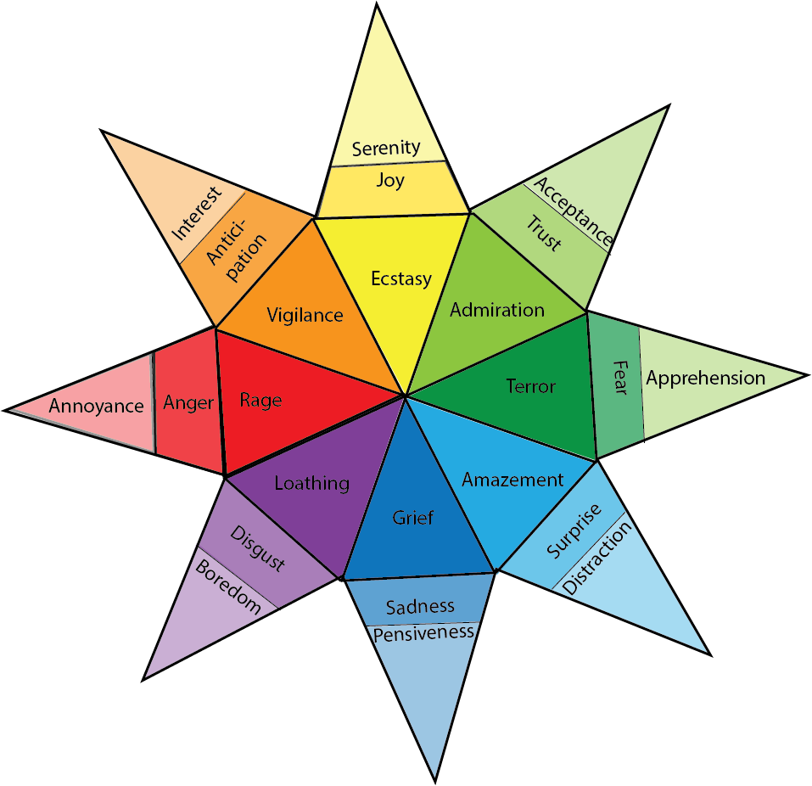
Mood and Emotion

Slide 12
Audio Research
Finding comparison material
Temp tracks

Slide 13
Audio Story Analysis
Sound selection:
How does genre affect sound design choices?
What sounds are used, where, and why?
How are characters delineated by sound?
What tropes or stereotypes are inherent in the sounds chosen?
Which sounds are symbolic or metaphoric and what do they signify?
What sounds are used (or emphasized) for believability, rather than realism?
Which sounds evoke a bodily response, and why? Which sounds evoke a haptic or visual response? What actions are heard in the sounds?

Slide 14
Audio Story Analysis
Effects (DSPs):
What effects are used, where and why?
What impact do the effects have on the listener and why?
As we have touched on to some extent, sound effects can alter the feeling of a particular sound.
How are flashbacks (if any), or in-head thoughts and feelings created sonically through effects?

Slide 15
Audio Story Analysis
Functions:
What functions does the sound play in the audio drama at different points, and why?

Slide 16
Audio Story Analysis
Mix:
How does foreground, middleground and background change in the mix (if at all)?
Are mixing choices are realistic or creative?
Why do you think they chose to mix it that way?
How is the sound mixed in relation to music and dialogue?
How is dynamic range used to emphasize certain sounds over others?
What is the most important scene and how is that shown in sound?

Slide 17
Audio Story Analysis
Structural:
How are scene changes shown in sound?
How do they build tension?
What sounds carry between scenes and why?
What sounds are specific to scenes and why?

Slide 18
Audio Story Analysis
Spatialization:
Is it in stereo, binaural audio or some other format? Why do you think they chose this format?
What tools are used to spatialize sound in a way that supports the story?
consider the different points of audition: how does the sound help us to empathize with characters through point of audition?
What techniques support the point of audition?

Slide 19
Spotting a script (* text from BBC radio series The Wire for the episode “The Startling Truths of Old World Sparrows” by Fiona Evans )
STAN’S KITCHEN. DAY.
DOG WHINES.
STAN
What’s the matter baby? Do you want to go out? She doesn’t like the snow, especially when it’s deep. With her being so small. Poor thing…
STAN UNLOCKS AND OPENS THE BACK DOOR
Her belly gets wet. Go on, go out for a wee.
KIDS LAUGHING. A WHEELY BIN IS KICKED OVER. THE KIDS CALL HIM NAMES
STAN GOES OUTSIDE. SHOUTING AFTER THEM.
KIDS RUN OFF.
Oi! What do you think you’re doing? Oi… Don’t you come near my house again, do you hear me?
Bloody snow! Can’t run in this can I?
What shall I do? I’ll clear the path. That way I can run after ‘em next time.

Slide 20
Steps to spotting a script
First read:
Read whole script, pay attention to objects, environments, actions, emotions.
Circle keywords that indicate special sounds.
Think about tension and release points
Write down any immediate thoughts or notes

Slide 21
Steps to Spotting a Script
Second read:
What can sound bring to the story?
What is the theme, and what sounds do you associate with it?
What sonic generalizations or stereotypes can you use?
How will you enhance mood/emotion of key scenes
What moods do you associate with what scenes?
What is the overall arc of emotion? What is the peak?
What is the genre and what sounds do you associate with it?

Slide 22
Cue Sheets
Identify individual cues in script and what sounds and music you want.
Types of music cues:
Bridge
Fades
Beds
Sting
Under
Duck Under
Establish
Play through and out

Slide 23
The Asset List
List of all sounds need to find, record, make or design.
Scene | Sound | Filename | Category | Notes | Finished?
Fireplace | Fire crackle | Fire_01.wav | Ambience | Loop. Still needs reverb. | -
Fireplace | Dog whimper | Dog_02.wav | Spot | Get John to voice this. | -

