Slide 1

Chapter 7
Surround and Spatial Sound

Slide 2
Outline
Human Sound Localization
Binaural Audio
In-Head Localization
Surround Sound
Ambisonics and Object-Based Audio
Spatial Sound
Sound Propagation

Slide 3
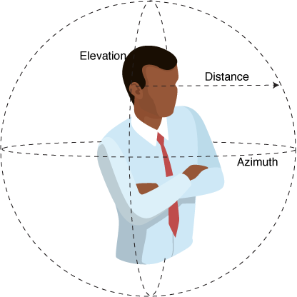

Human Sound Localization

Slide 4
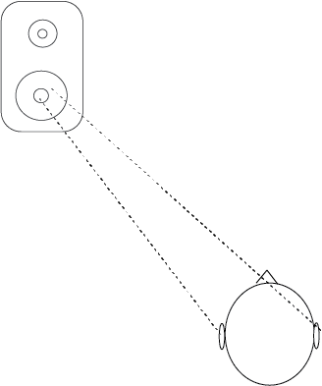
How sounds reach our ears
ILD: Interaural Level Difference
ITD: Interaural Time Difference

Slide 5
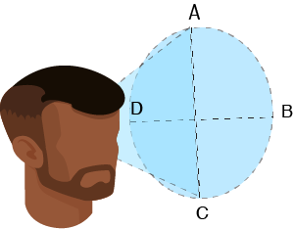
Cone of Confusion

Slide 6
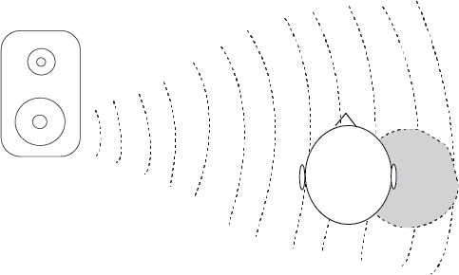
How sounds reach our ears
Spectral cues
HRTF: Head related transfer function

Slide 7
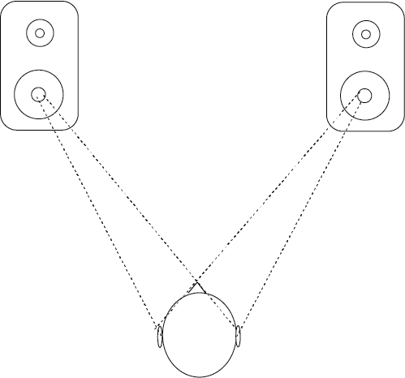
Binaural Audio
Two channel audio: two ears
Cross-talk over speakers
Headphones: isolate one channel

Slide 8
Binaural recording
Not just 2 mics, requires head(ish) & pinnae for HRTFs
3dio.com
Neumann.com

Slide 9
Binaural Plug-ins
Ambeo Orbit (free) in Audition

Slide 10
In-Head Localization

Slide 11
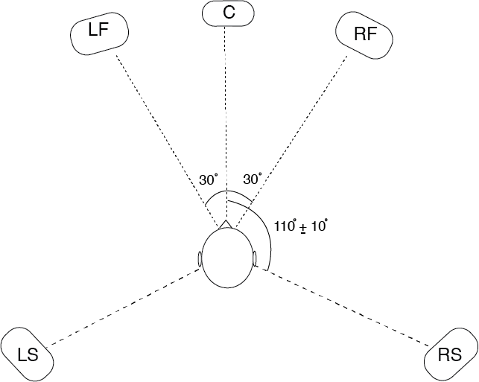
Surround Sound
Two channel audio: two ears
Cross-talk over speakers
Headphones: isolate one channel

Slide 12
Surround mixing in Audacity
Drag to reassign
File>Export>Export as Wav then hit Save.
Advanced Mixing Options window

Slide 13

The Exit Sign effect
http://www.torchstar.us/ul-listed-led-exit-sign-light.html

Slide 14
Spatial Audio Rendering

Slide 15
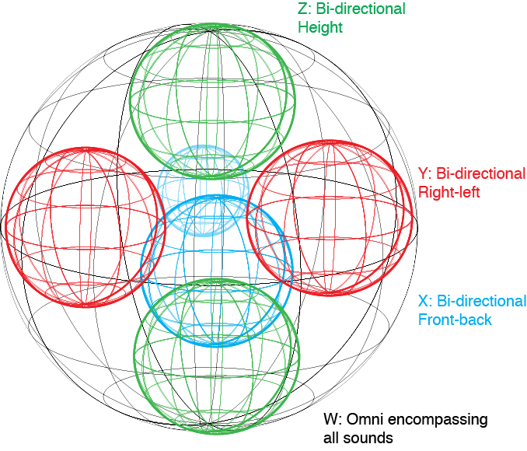
Ambisonics
Encoding: B-Format: 4 channels, W, X, Y, Z
W: omni
X: figure8 pointing forward
Y: figure8 pointing left
Z: figure8 pointing up

Slide 16
Ambisonics mixing tools
Waves B360
https://www.waves.com/plugins/b360-ambisonics-encoder

Slide 17
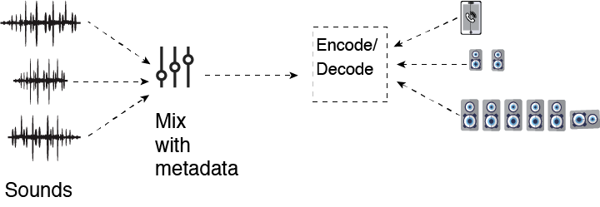
Object-based Audio

Slide 18
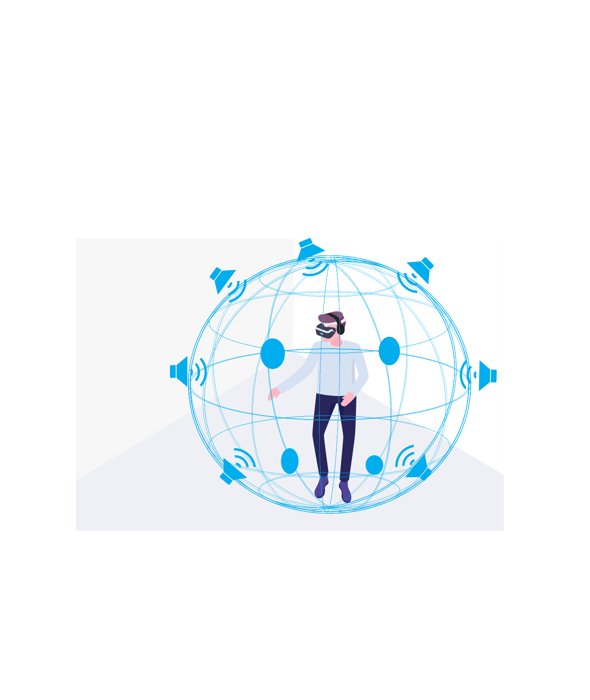
Spatial Audio
Rendering software based
Head-tracked vs Head-locked

Slide 19
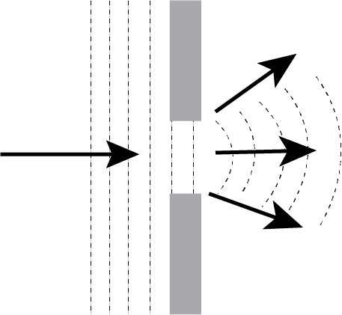
Sound Propagation
Diffraction: Path of sound around obstacles

Slide 20
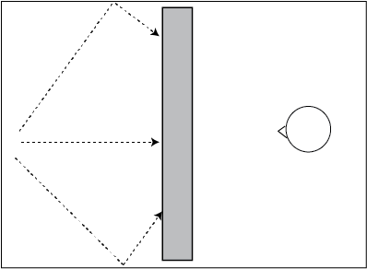
Sound Propagation: Occlusion

Slide 21
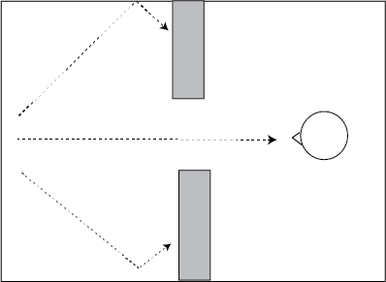
Sound Propagation: Exclusion

Slide 22
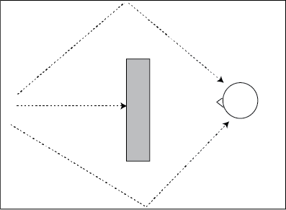
Sound Propagation: Obstruction

