Slide 1
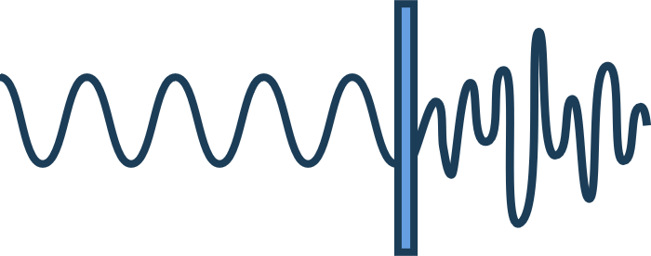
Chapter Five
Effects

Slide 2
OUTLINE
Tremolo & Vibrato
Pitch Shifting & Auto-Tune
Equalization (EQ)
Filters
Modulation
Distortion

Slide 3
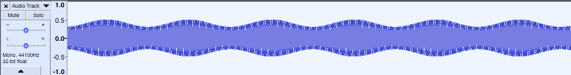
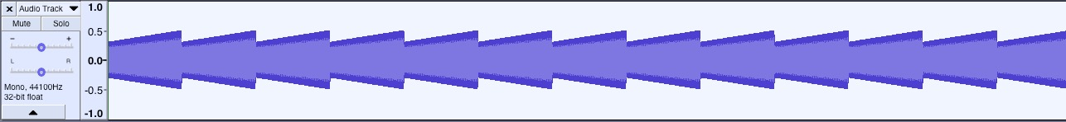
Tremolo
“trembling” - Modulates amplitude

Slide 4
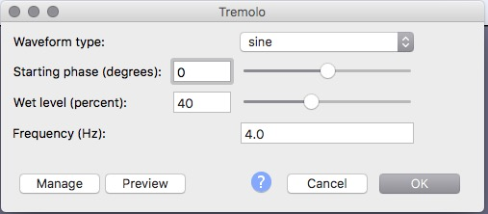
Tremolo in Audacity
Waveform Type: alters shape of amplitude pattern
Starting phase: where to start in cycle
Wet level: depth of sweep of amplitude
Frequency: speed of oscillation (how “trembly”)

Slide 5
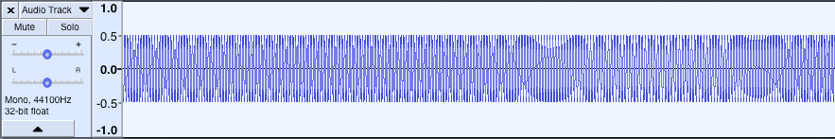
Vibrato
“vibrare” = to vibrate
Modulates Frequency
whammy bar
https://www.yellowpages.ca/tips/ using-a-tremolo-bar-while-playing-guitar/

Slide 6
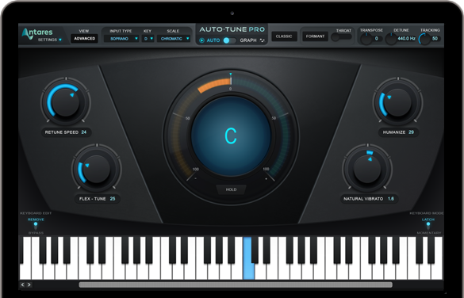

Pitch shifting & Auto-Tune
Pitch = Frequency
Auto-Tune = Antares Plug-In
Antarestech.com

Slide 7
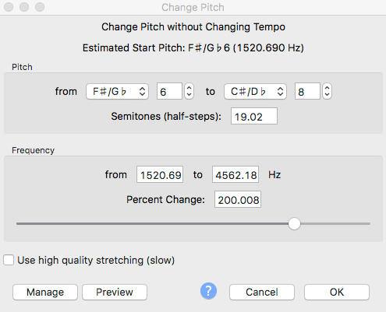
Pitch Shifting in Audacity
Effects > Pitch Change
Pitch OR Frequency

Slide 8
Equalization
Realhdaudio.com
Thomann.de
Yamaha.com

Slide 9
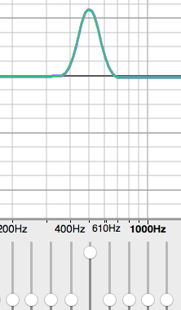
EQ
Bands: group of frequencies
Bandwidth: set of bands affected by slope
Q value: ratio of centre frequency to bandwidth: increase Q = lower bandwidth

Slide 10
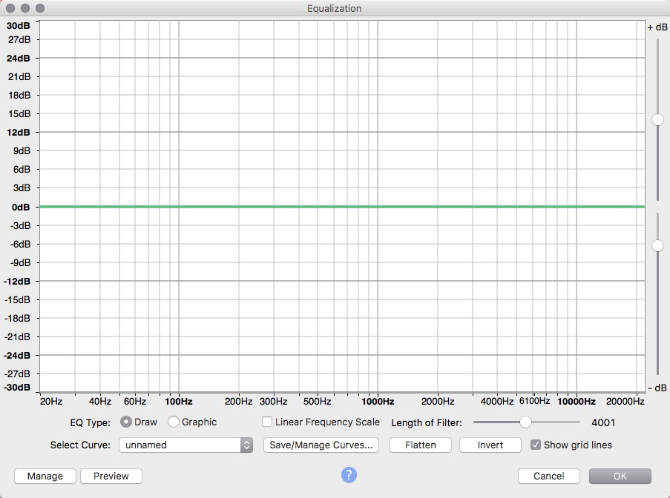
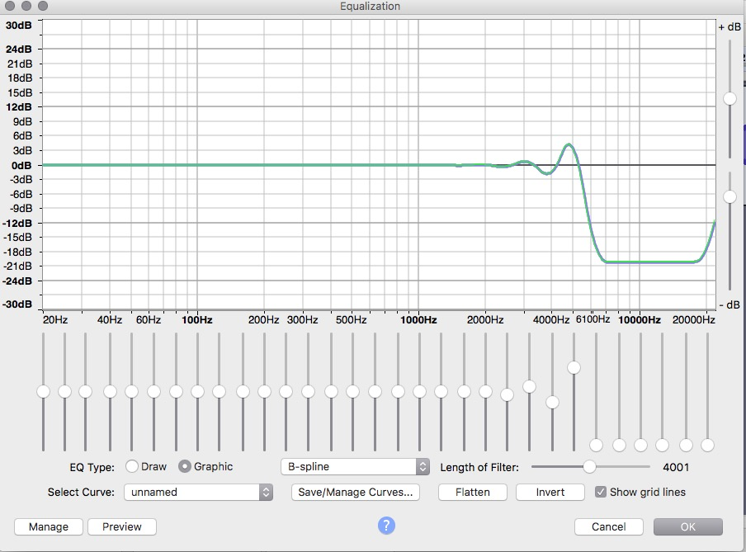

EQ in Audacity
Draw: Draw your own curves
Graphic: Faders

Slide 11
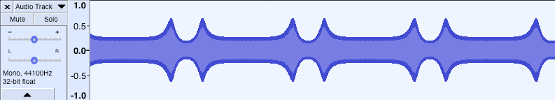
Wah-Wah
Variable EQ with sweep of frequency band

Slide 12
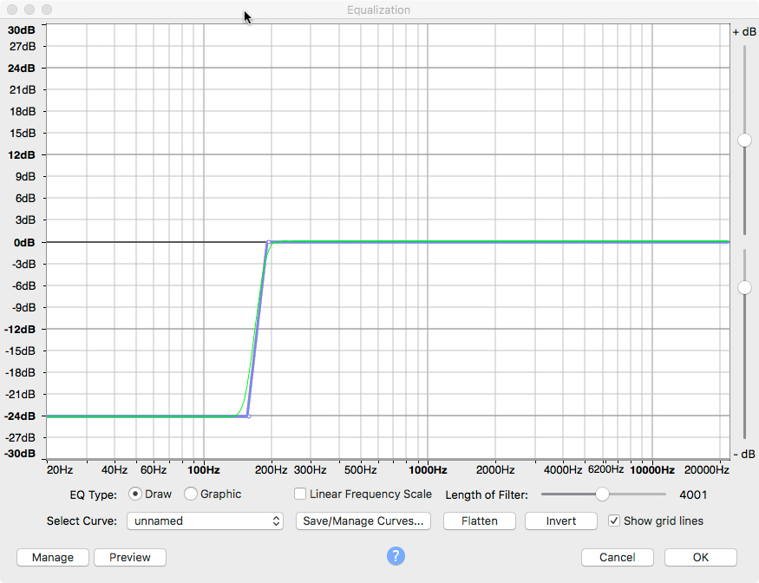
Filters
Low Pass
High Pass

Slide 13
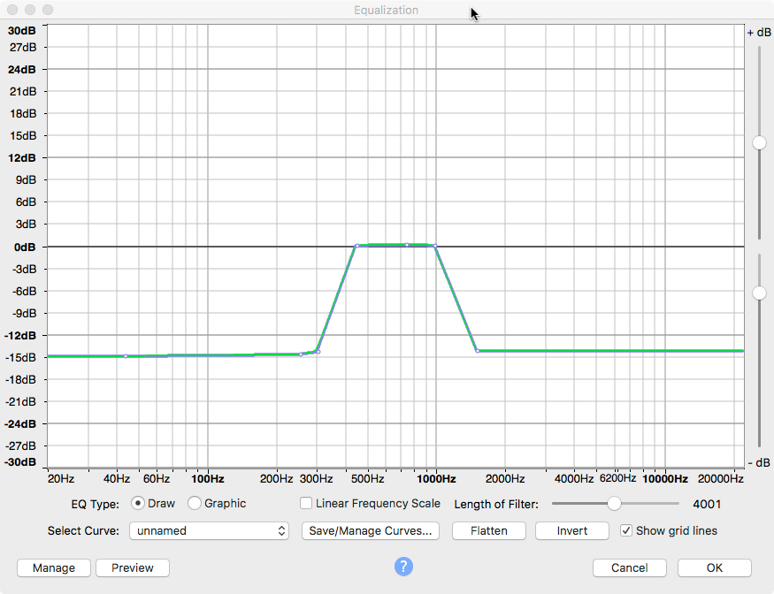
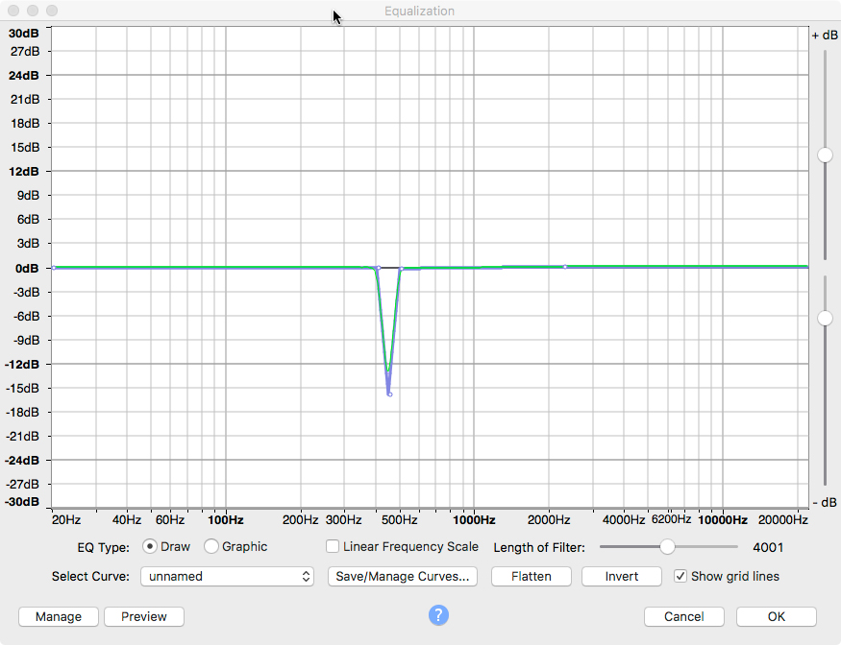
Filters
Low Pass
Band Pass
High Pass
Notch

Slide 14
Ring Modulator
Remember Combination Tones
Ring Modulator = Sum and Difference of inputs

Slide 15
Distortion
Overdrive: “soft clipping”
Distortion: “hard clipping”
Fuzz: hard clipping + saturation of harmonics

Slide 16
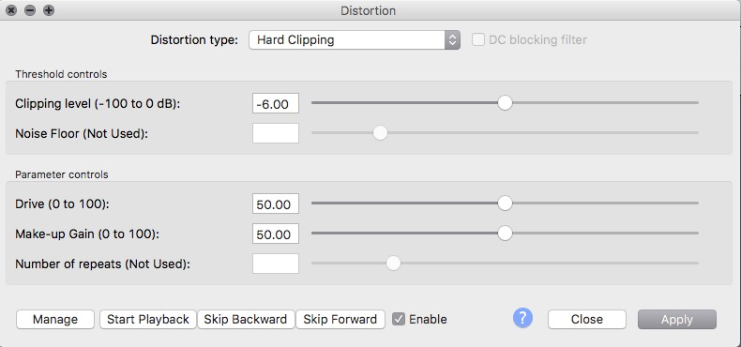
Distortion in Audacity
Clipping Level: peaks greater than level are clipped
Drive: amount signal amplified before clipping
Make-Up Gain: overall output amplification
Distortion Amount: Strength of distortion

