Slide 1

Chapter 4
Sounds in Space

Slide 2
OUTLINE
Doppler
Reverberation
  Reflections
  Flutter & Standing Waves
  Resonance
Absorption & Diffusion
Digital Reverb
Echo and Delay

Slide 3
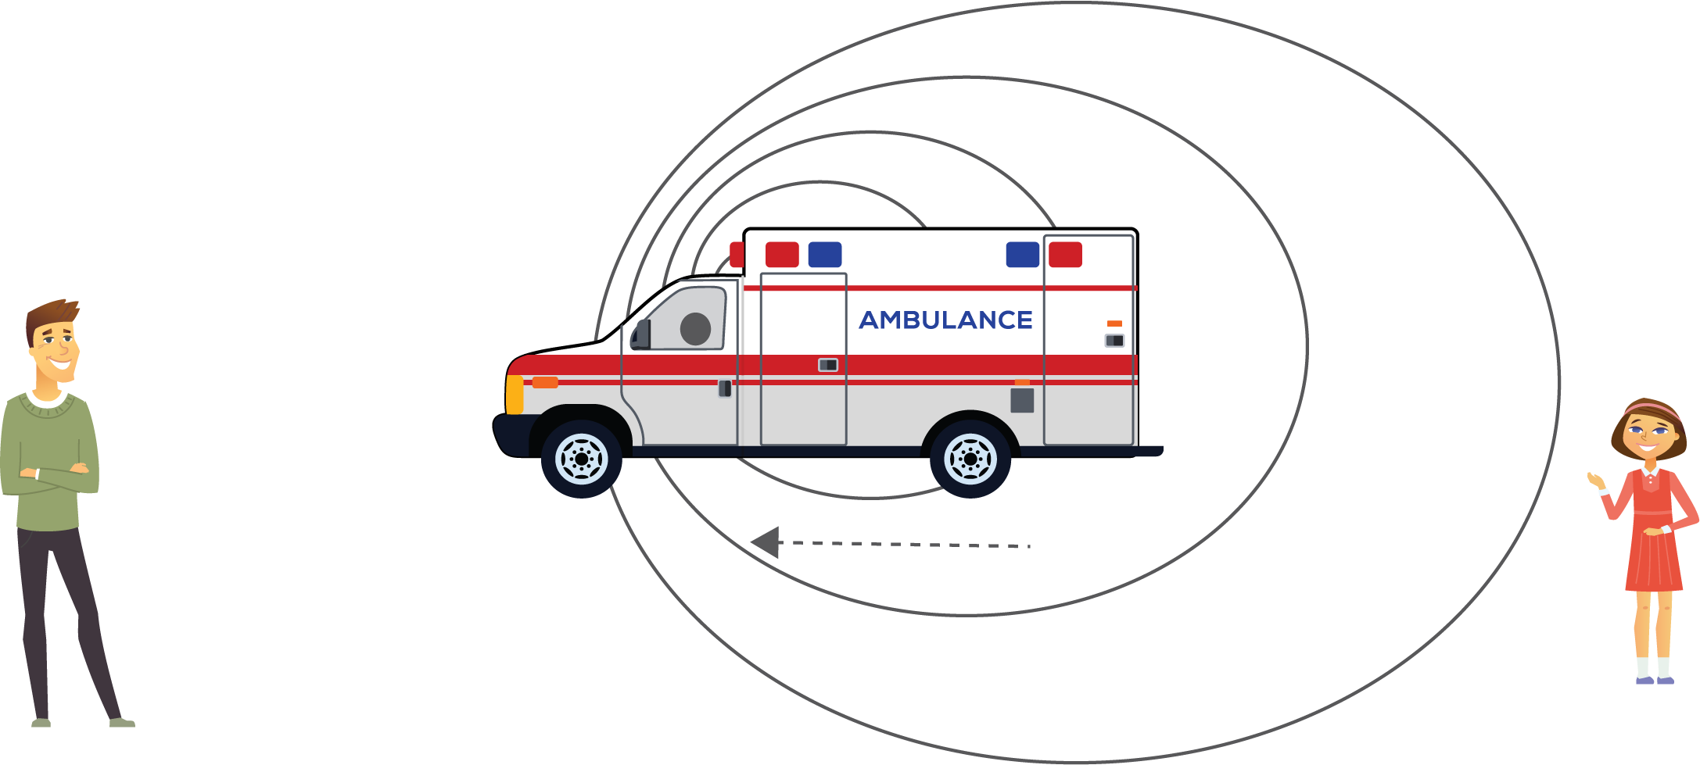
Doppler Effect

Slide 4
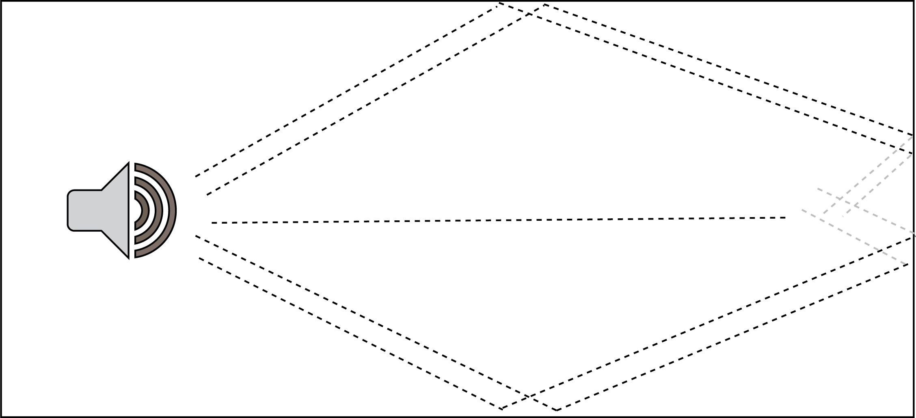
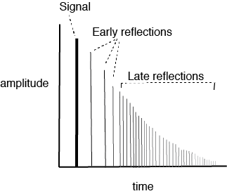
Reverberation: Reflections

Slide 5
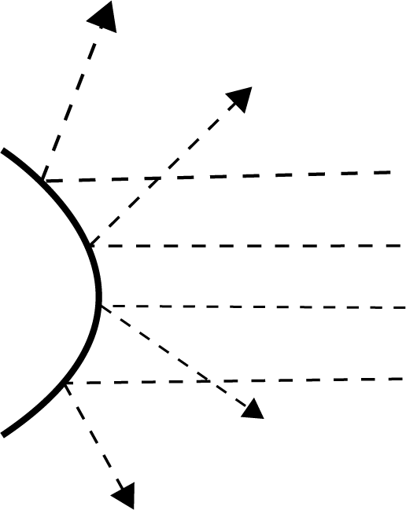
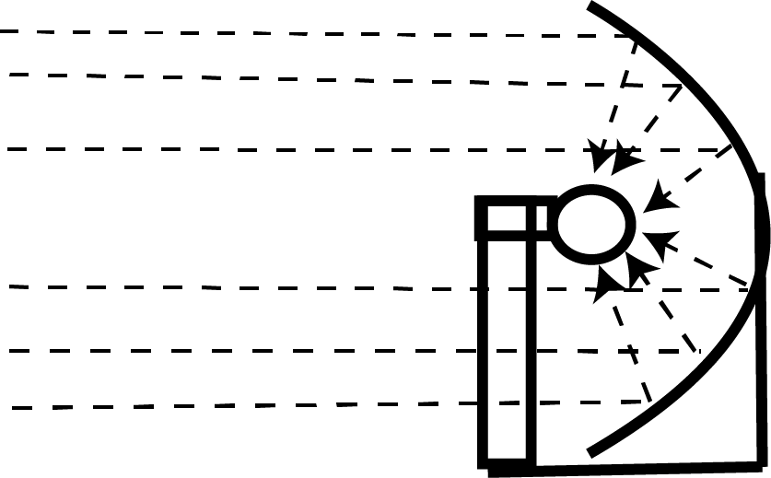
Parabolas

Slide 6
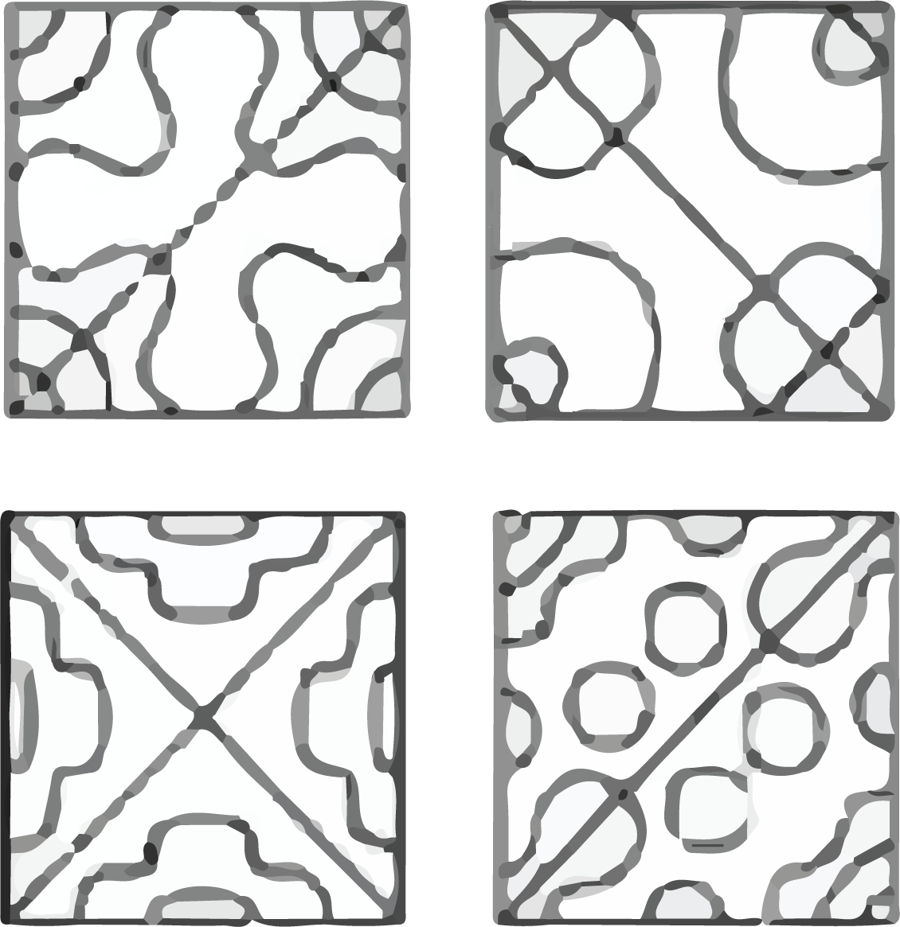
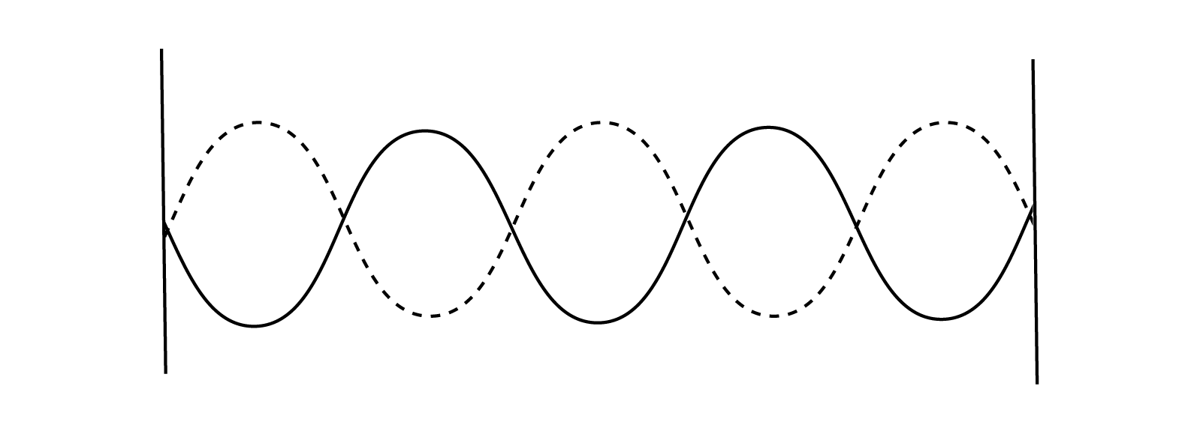
Standing Waves
Chladni Plate Patterns

Slide 7
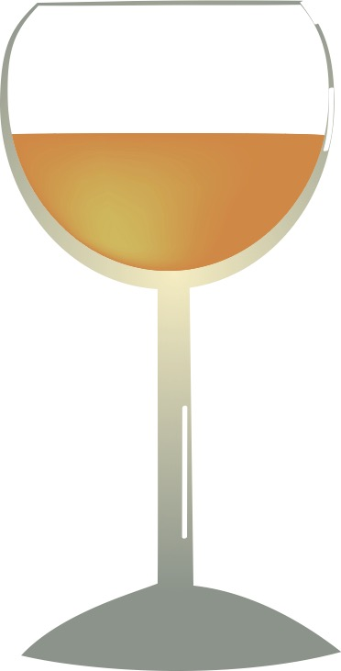
Resonance
Pasco.com

Slide 8
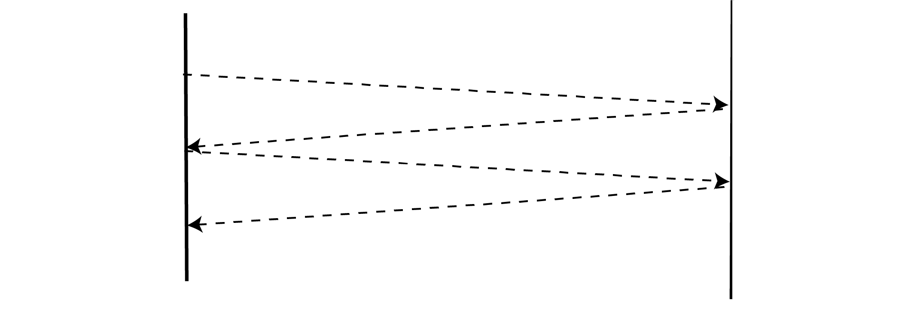
Flutter

Slide 9
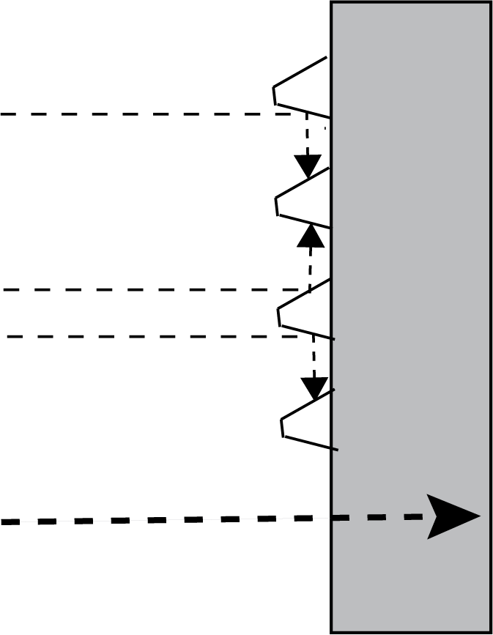
Absorption & Diffusion
DIFFUSION
Keepitquiet.co.uk
Alphacoustic.com
ABSORPTION

Slide 10

REVERB IN AUDACITY
Reverb added

Slide 11
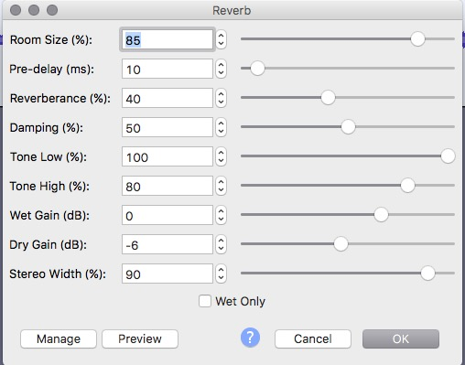
Reverb Settings
Room Size: simulated space
Predelay: How much time before first reflection
Reverberance: Length of tail
Damping: high frequencies decay more quickly
Tone Low: reduce low freq
Tone high: reduce high freq
Wet gain: increase volume of reverb
Dry gain: increase volume of signal
Stereo width: channel separation
Wet only: remove original signal

Slide 12
Preverb
Duplicate a sound file (Ctr/Cmd A, Ctrl/Cmd C + tracks > add new > mono track, Ctrl/Cmd V)
Reverse Track 2 (Effects > Reverse)
Apply reverb Effects > Reverberation > Manage> Factory Presets > Large Room
Reverse Track 2 again (Effects > Reverse)
Tracks > Mix > Mix and Render

Slide 13
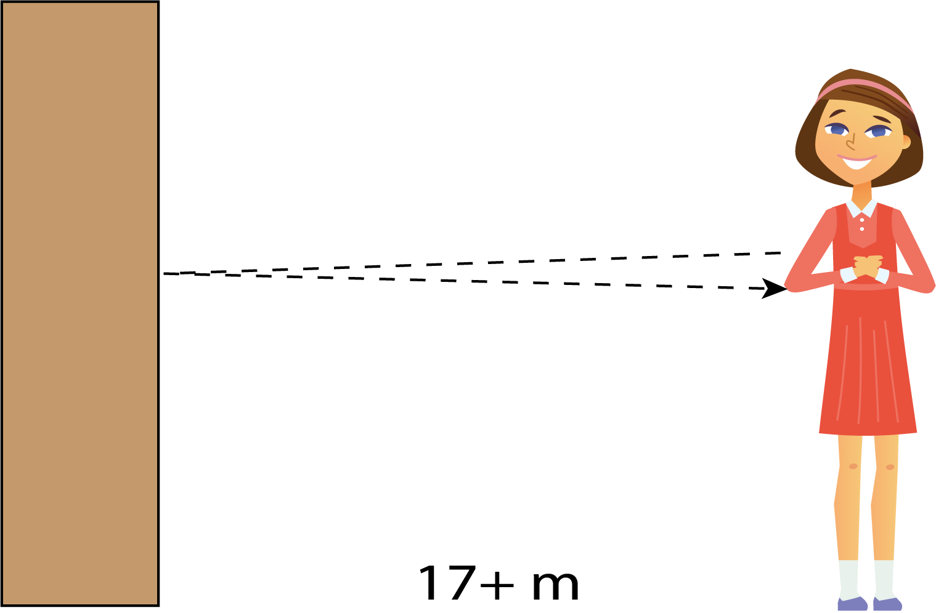
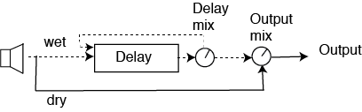
Echo and Delay

Slide 14
Delay
Original sound
delays

Slide 15
Delay
Delay Type: regular, bouncing ball (reduces time as repeats), reverse bouncing ball (increases time as repeats)
Delay Level Per Echo: Amount of change in amplitude in each delay
Delay Time: time between repeats
Pitch Change Effect: delay will change frequency/tempo
LQ Pitch Shift: Changes frequency while maintaining time
Pitch change per echo: in semitones

Slide 16
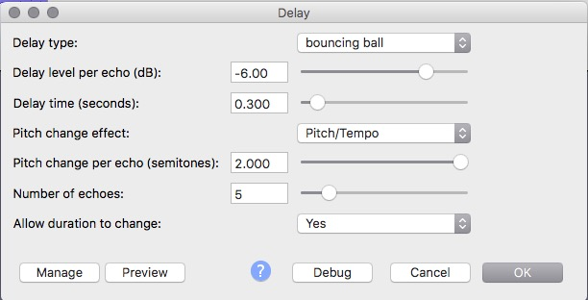
Delay
Number of Echoes: how many times repeats
Allow duration to change: ***need room in file for delay

Slide 17
ADT & Chorus
Chorus: Multiple delays with deviations to create effect of chorus singing
Automatic Double Tracking: ADT: automated chorus-style effect

Slide 18
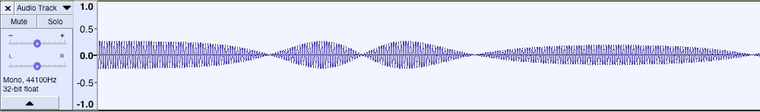
Phaser (Phase Shifter)
Uses constructive and destructive interference ”swept” by LFO

Slide 19
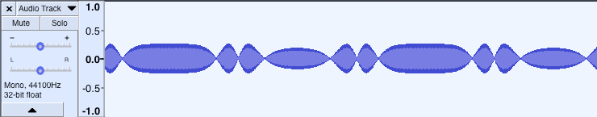
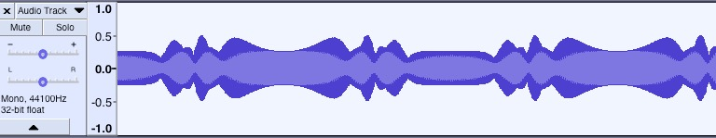
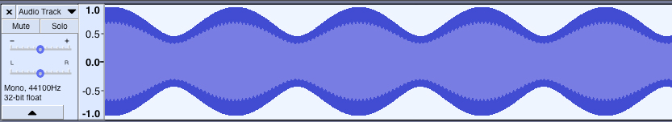
Phaser (Phase Shifter) and Flanger
Phaser on sine wave
Phaser on square wave
Flanger on sine wave

Slide 20
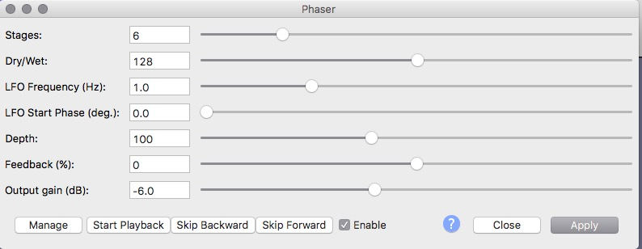
Audacity Phaser
Stages: more = stronger effect
Dry/Wet: 0 = unprocessed, 255 = only delay. Most = 128
LFO Freq: adjusts sweep rate
LFO start: starts in cycle
Depth: How high sweep is
Feedback: feeds signal back into phaser
Gain: increase output amplitude

Slide 21
Time Stretching
Original
Effect > Change Tempo
Effect > Change Speed

Slide 22
Worldizing– Walter Murch

