Slide 1
Chapter 3
Recording Sound

Slide 2
OUTLINE
Slating Audio
Stereo or Mono?
Microphones
Recording Accessories
Side address/ Top Address
Axis
Distance/ Proximity Effect
Feedback
Phasing
Input Gain
Stereo Miking
Proxemics

Slide 3

Slating
Date & Time of Day
location
Temperature/wind/weather (if relevant)
Subject being recorded
Gear being used
2 seconds top and tail
Hollywoodclapperboards.com

Slide 4
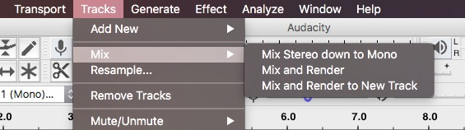
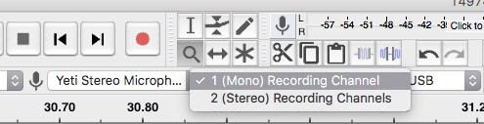

Stereo or Mono?
Mono: one channel, one + speakers
Stereo: two channels, two + speakers

Slide 5
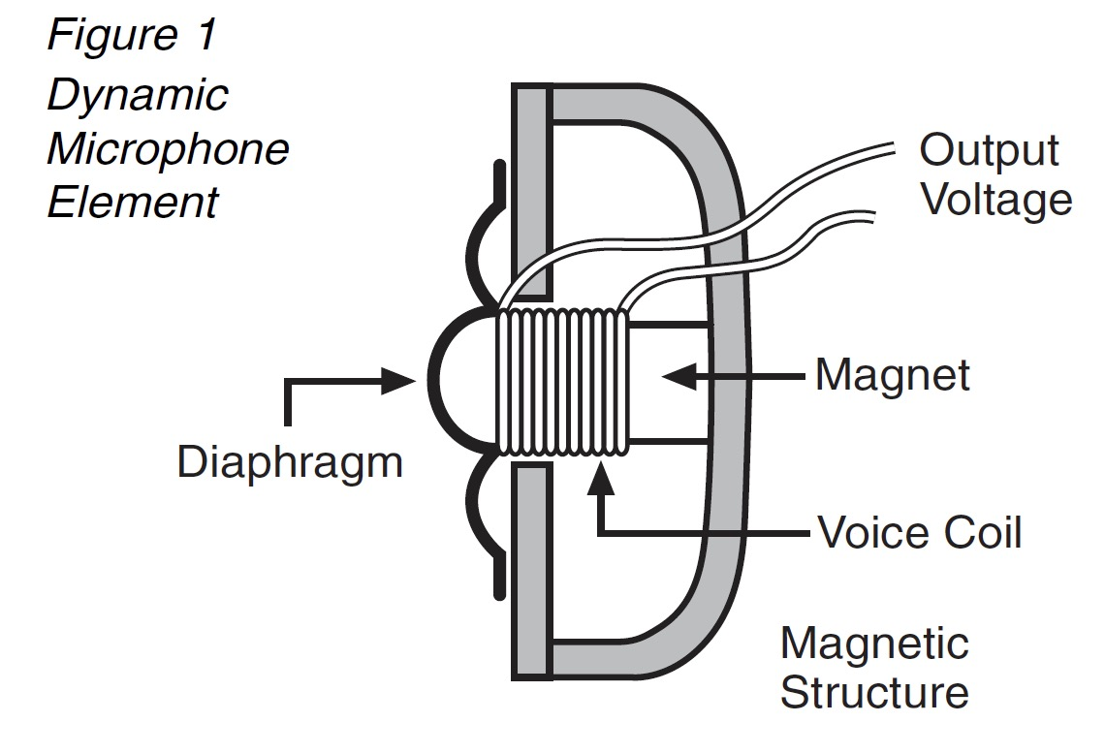
Microphones: Dynamic
Audio Technica’s Brief Guide to Mics

Slide 6
Microphones: Dynamic
Shure SM57 & 58
No external power needed
Good signal/noise
Rugged
Affordable (comparatively)
Not as fast transient response
All photos in this section from manufacturers

Slide 7
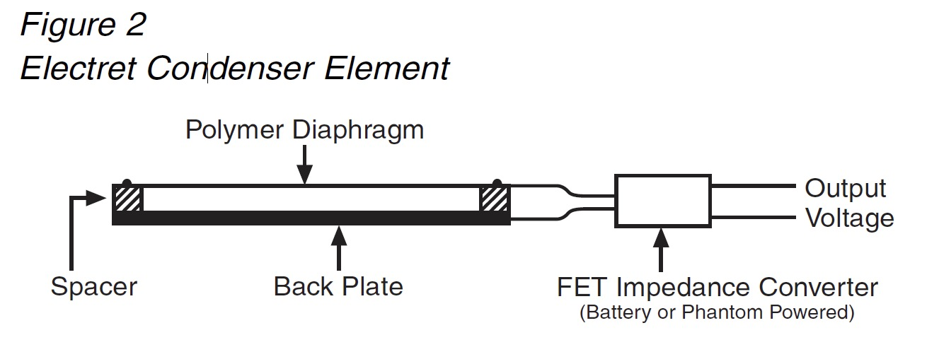
Microphones: Condenser
Audio Technica’s Brief Guide to Mics

Slide 8
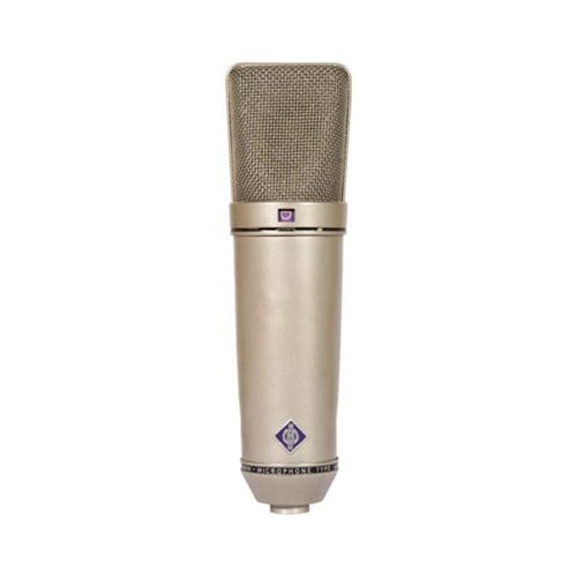
Microphones: Condenser
Neumann U87
External power often needed
More uniform response
More delicate
Better High frequency & soft sounds
fast transient response

Slide 9
Other Types of Microphones
RIBBON MIC
USB MIC* usually condenser
MXL R77 Classic Ribbon Microphone
Blue Yeti
STEREO MIC* usually condenser
BINAURAL MIC*
usually condenser
Rode NT4
3Dio FS Pro II

Slide 10
Other Types of Microphones
SURROUND MIC*
usually condenser
LAVALIER MIC*
usually condenser
Holophone
Audio Technica AT899c
CONTACT MIC
Schertler Dyn-Uni-P48

Slide 11
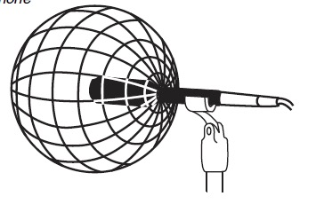
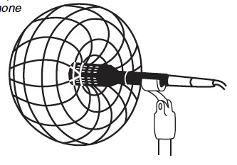
POLAR PATTERNS
OMNI
CARDIOID
Images: AudioTechnica Brief Guide to Mics

Slide 12
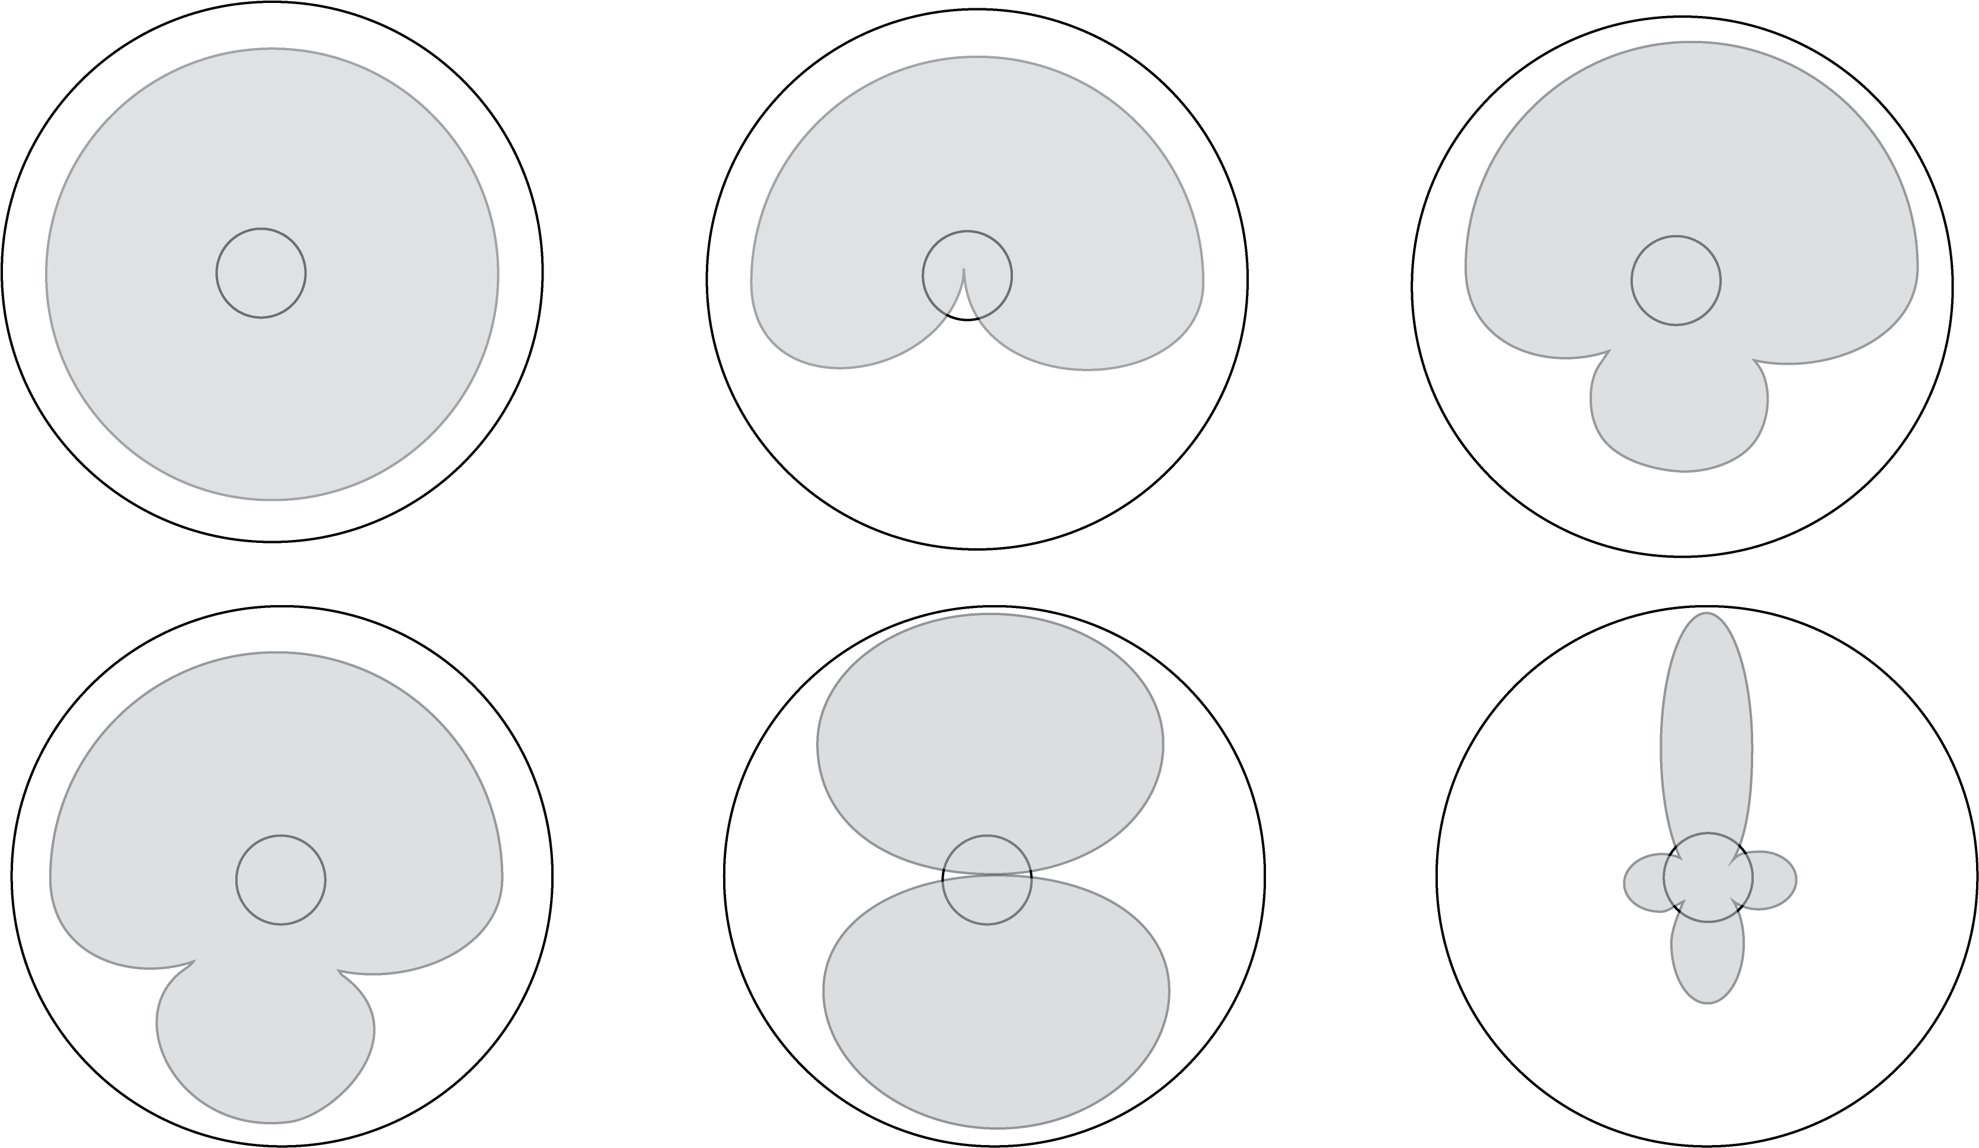
Polar Patterns
Super
cardioid
Omni
Cardioid
Bidirectional
Hypercardioid
Shotgun

Slide 13
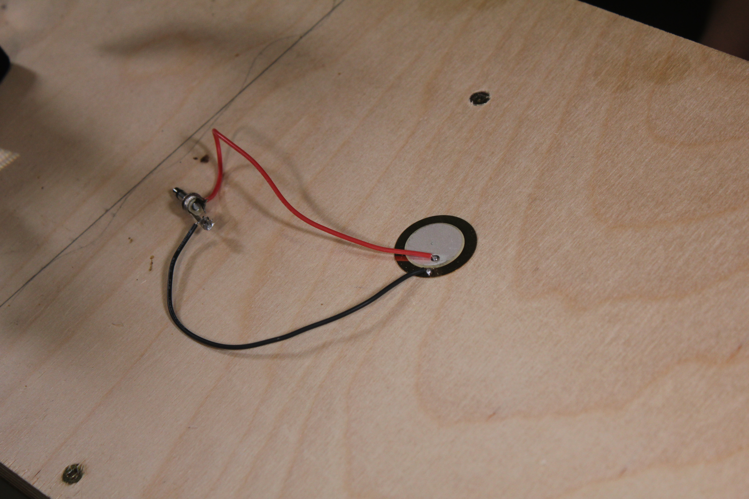
Build a Contact Microphone

Slide 14
Recording Accessories
Boom Pole
Mic Stand
Shock Mounts

Slide 15
Recording Accessories
Pad
Windscreens
Pop Filter

Slide 16
Recording Accessories
Phantom Power
Pre-Amp
Recorders

Slide 17
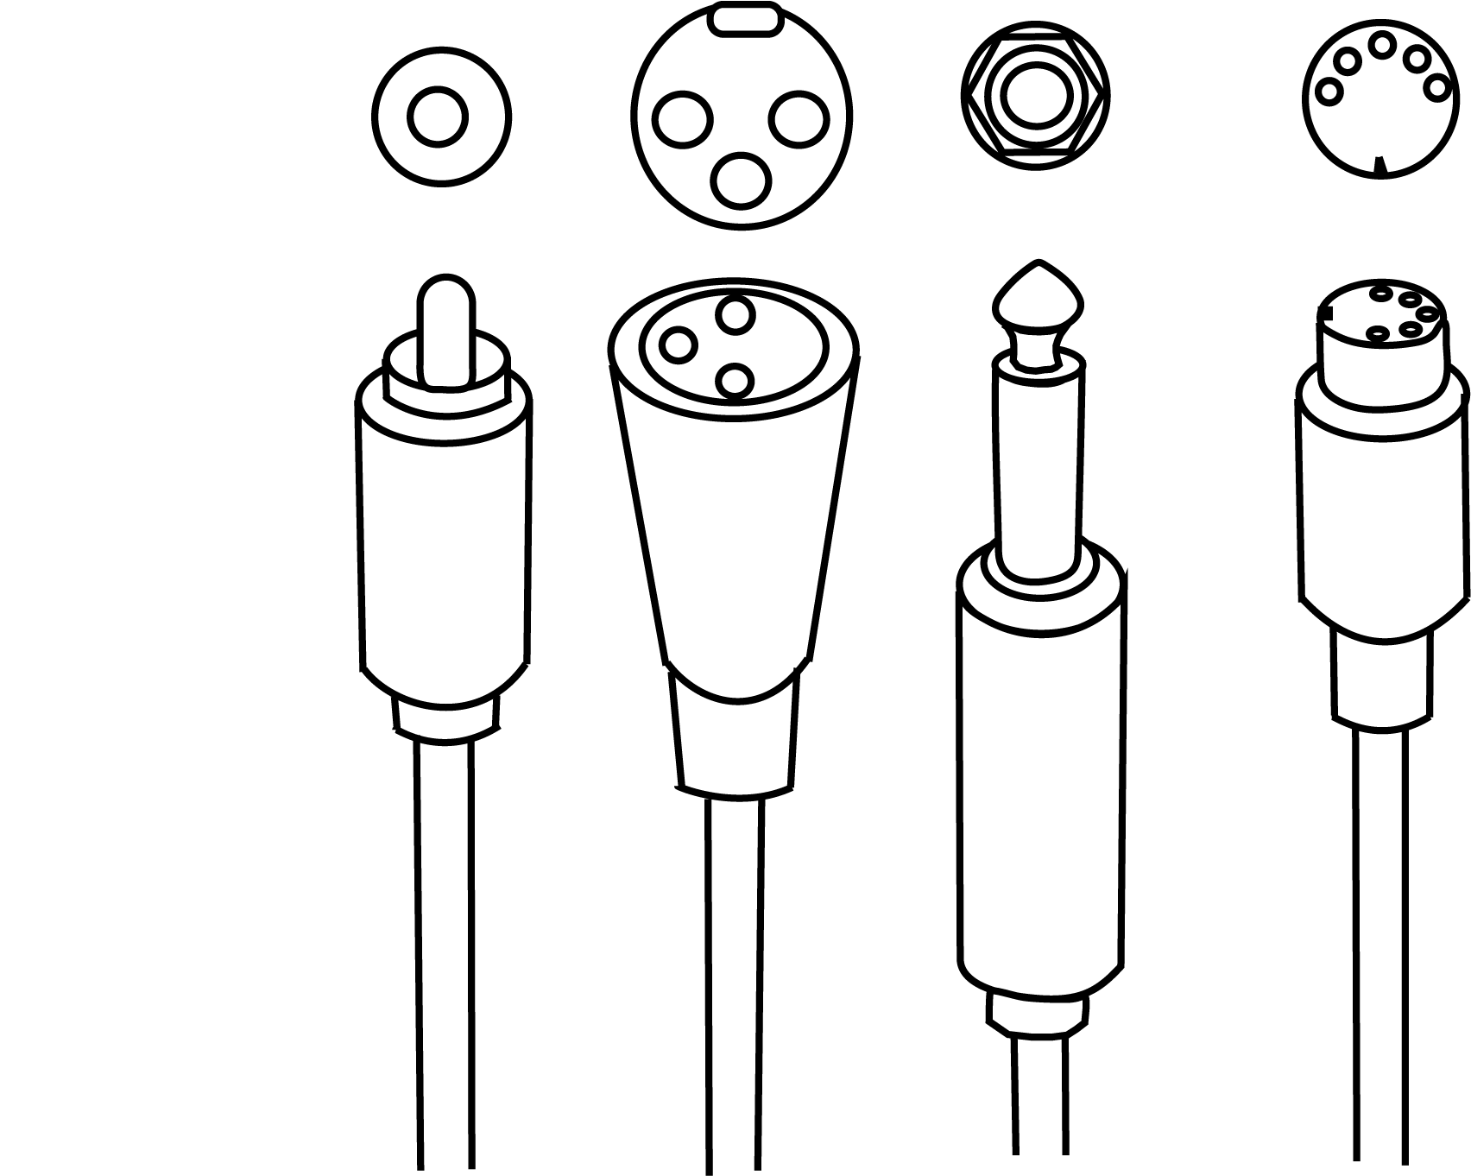
Cables
SPDIF
RCA
XLR
MIDI
TR/
*TRS

Slide 18
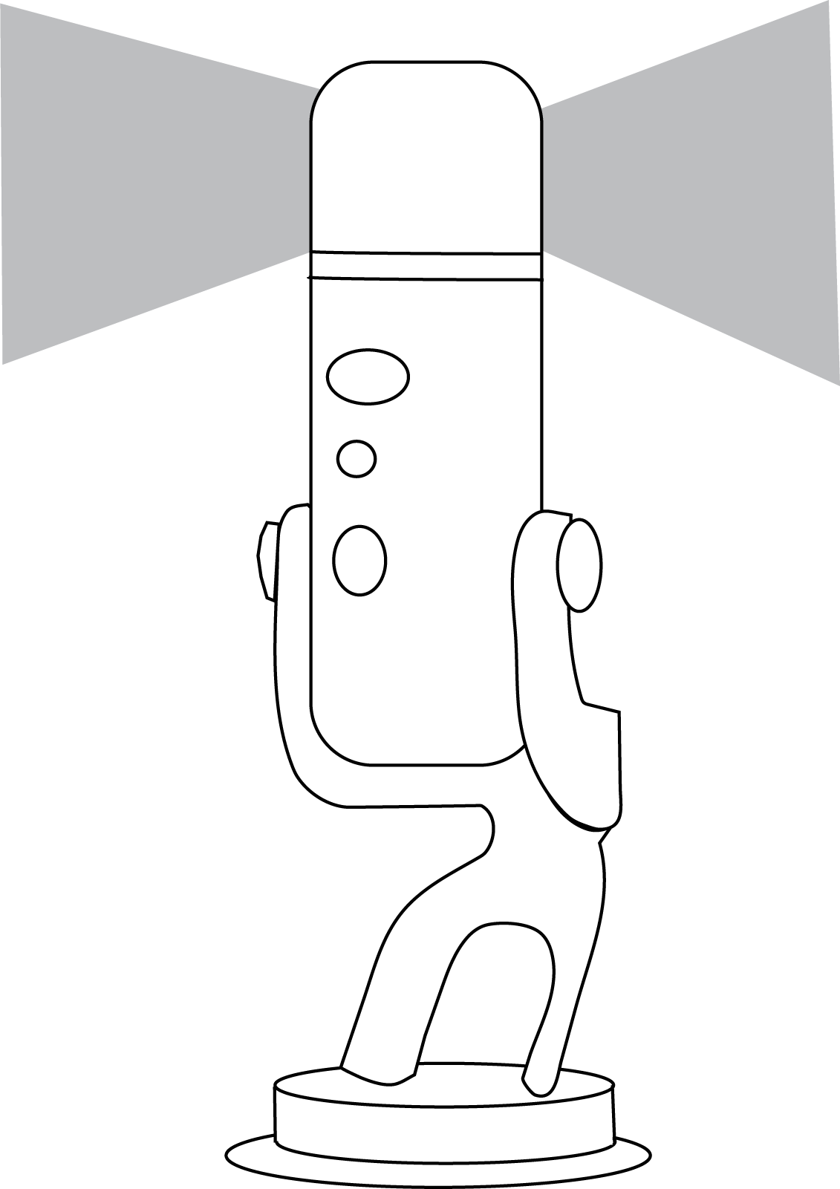
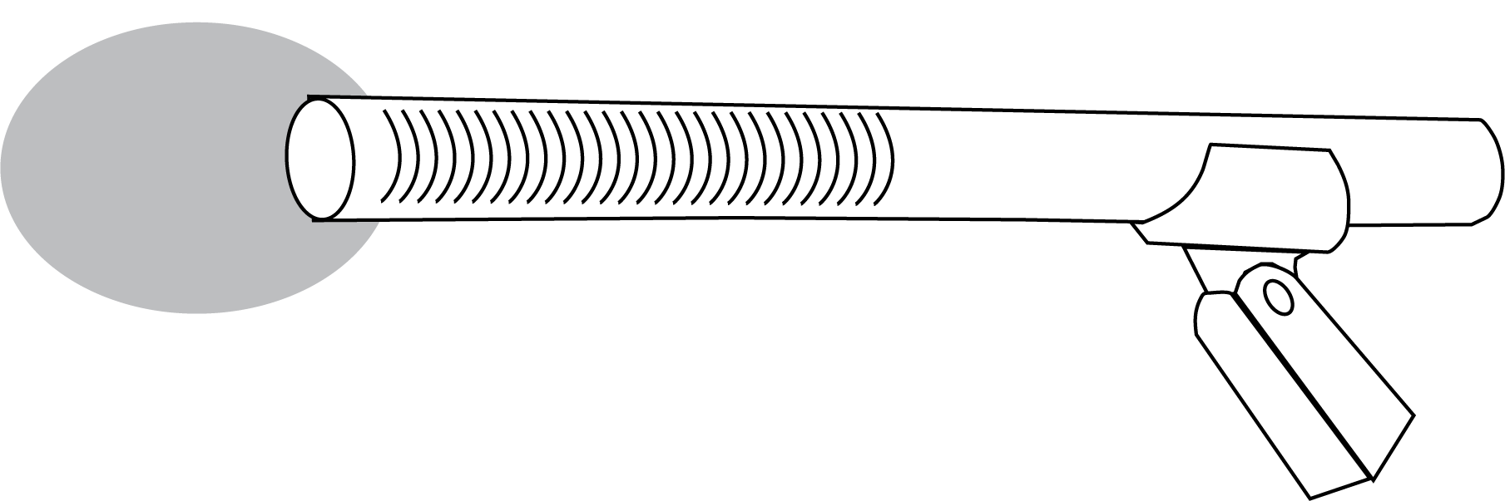
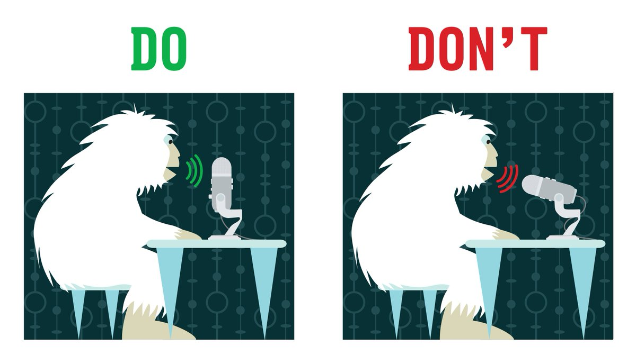
Side/ Top Address Mics
bluedesigns.com

Slide 19
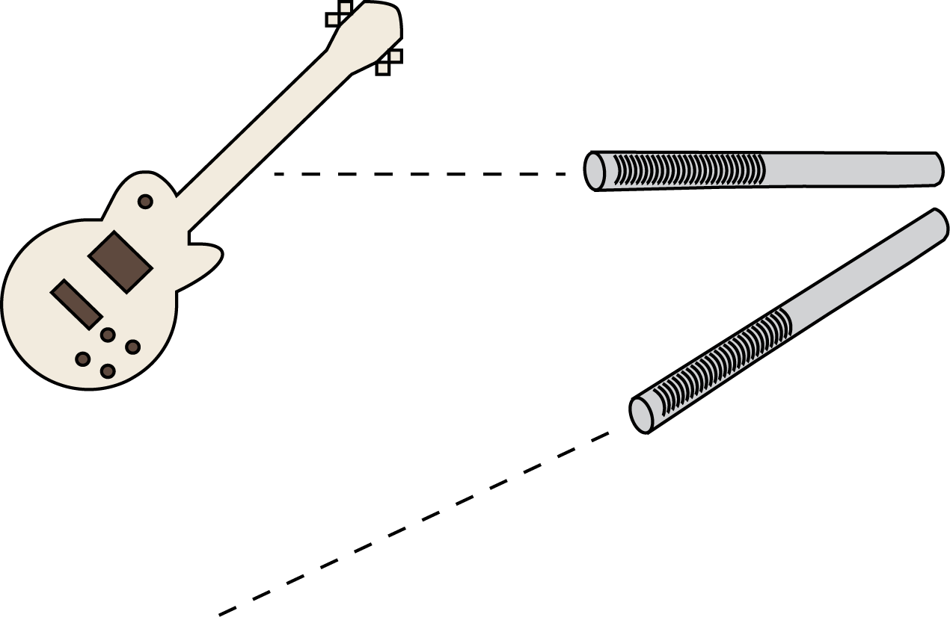
Microphone Axis

Slide 20
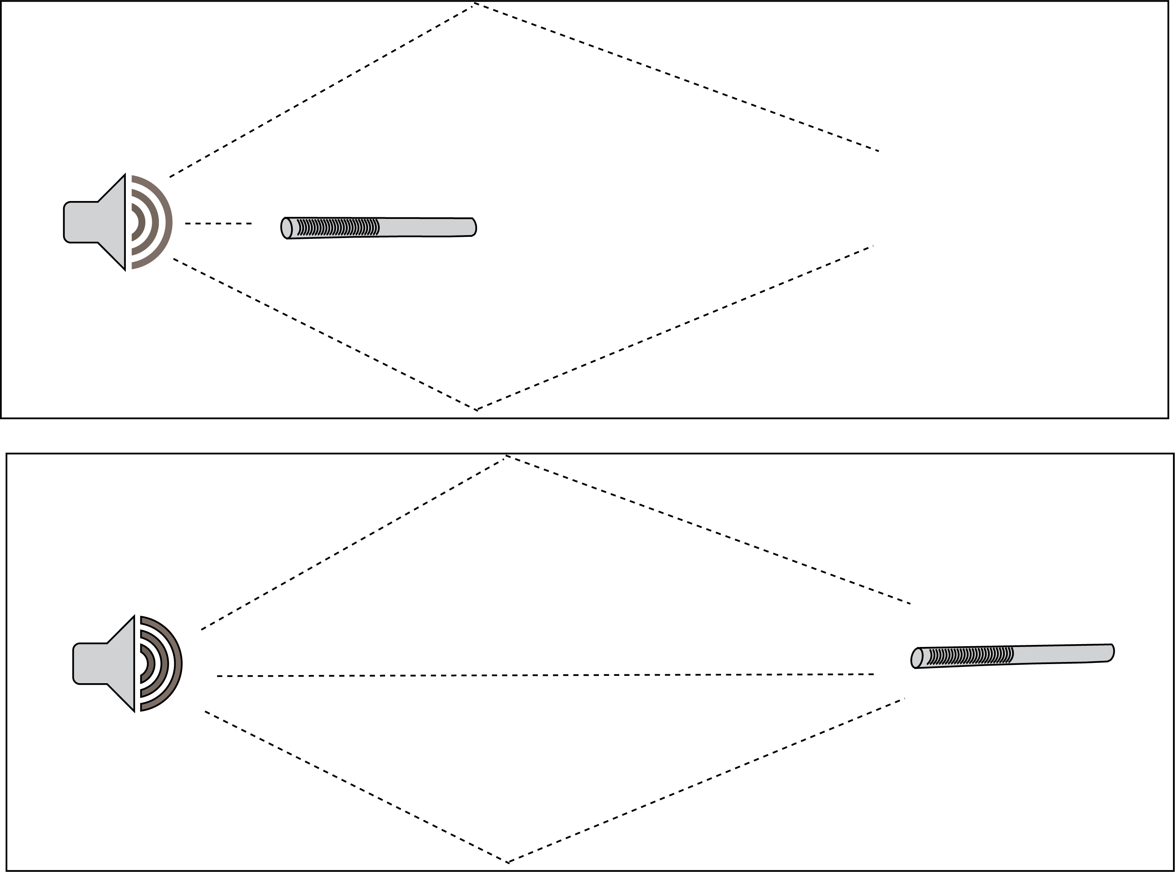
Distance

Slide 21
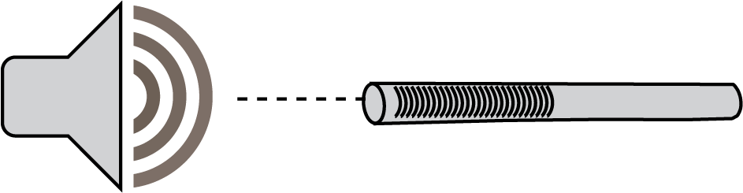
Proximity Effect
< 30 cm
Increase < 200 Hz

Slide 22
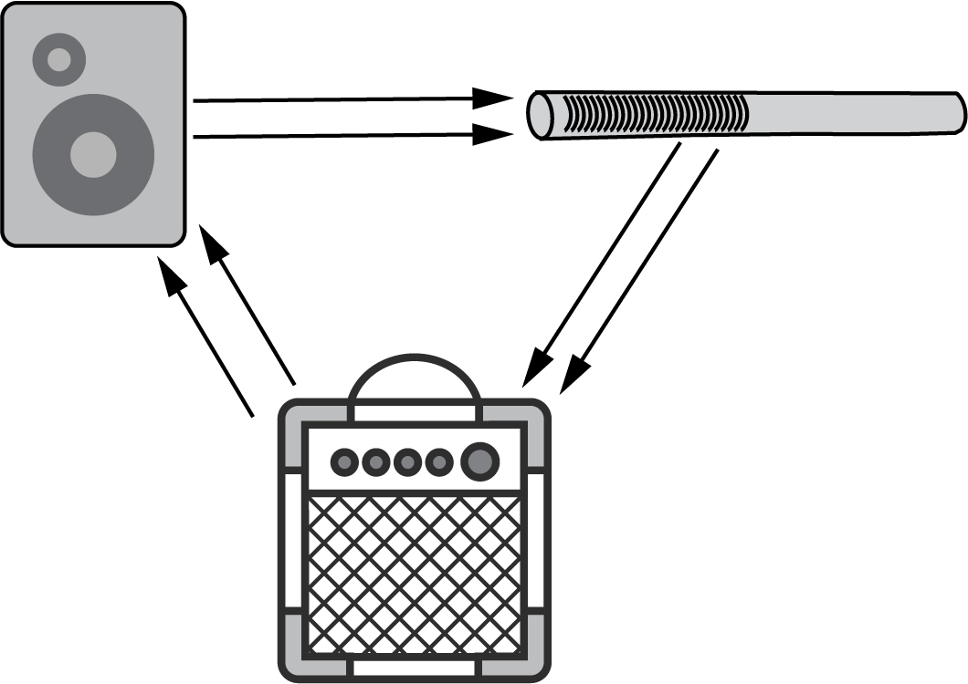
Feedback

Slide 23
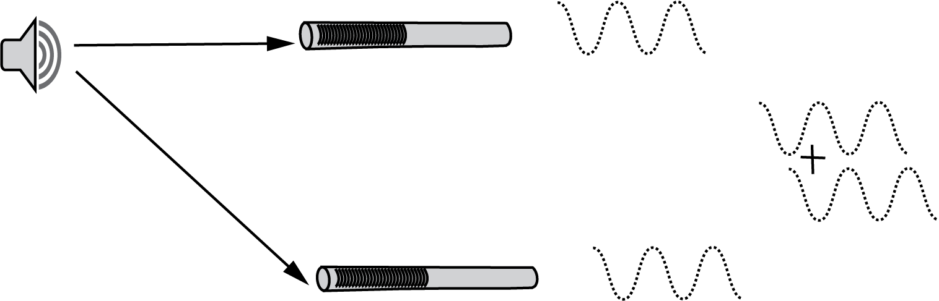
Phasing

Slide 24


Input Gain
“Gain” versus “Volume”
https://alisocreek.net/vo-blog/wp-content/uploads/2016/05/yeti-gain.jpg

Slide 25



Input Gain: Audacity
CP: current peak
RP: recent peak
MP: Maximum peak
CLIP: Clipping indicator
Manual.audacityteam.org

Slide 26
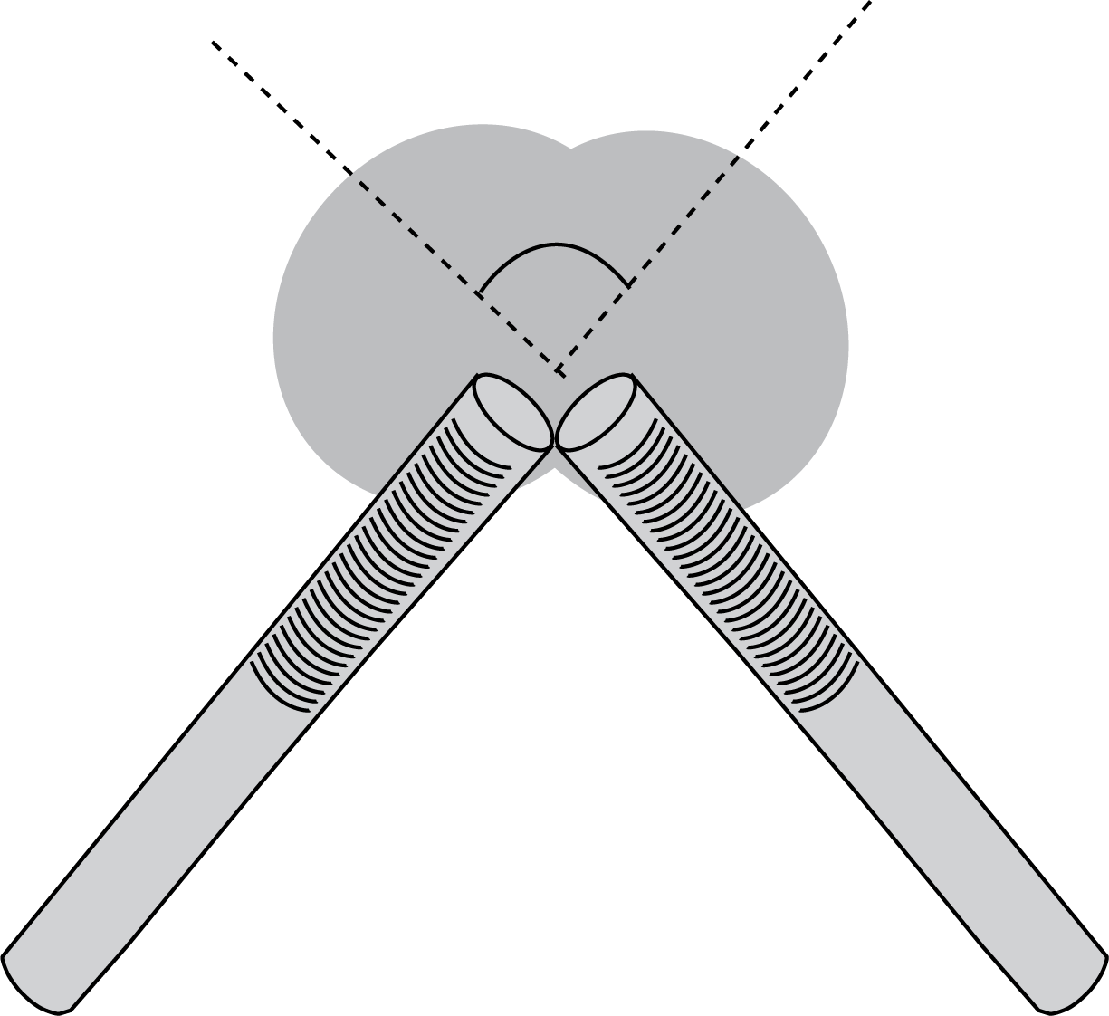
Stereo Recording: XY

Slide 27
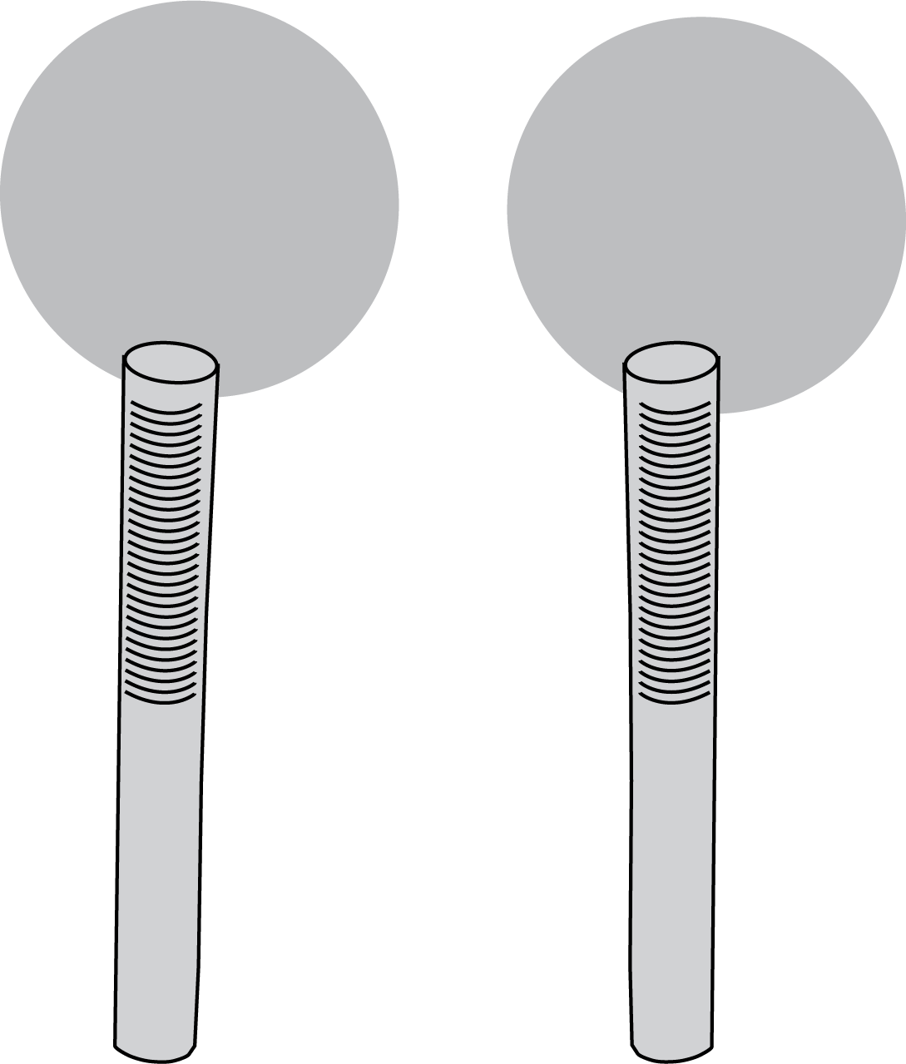
Stereo Recording: AB

Slide 28
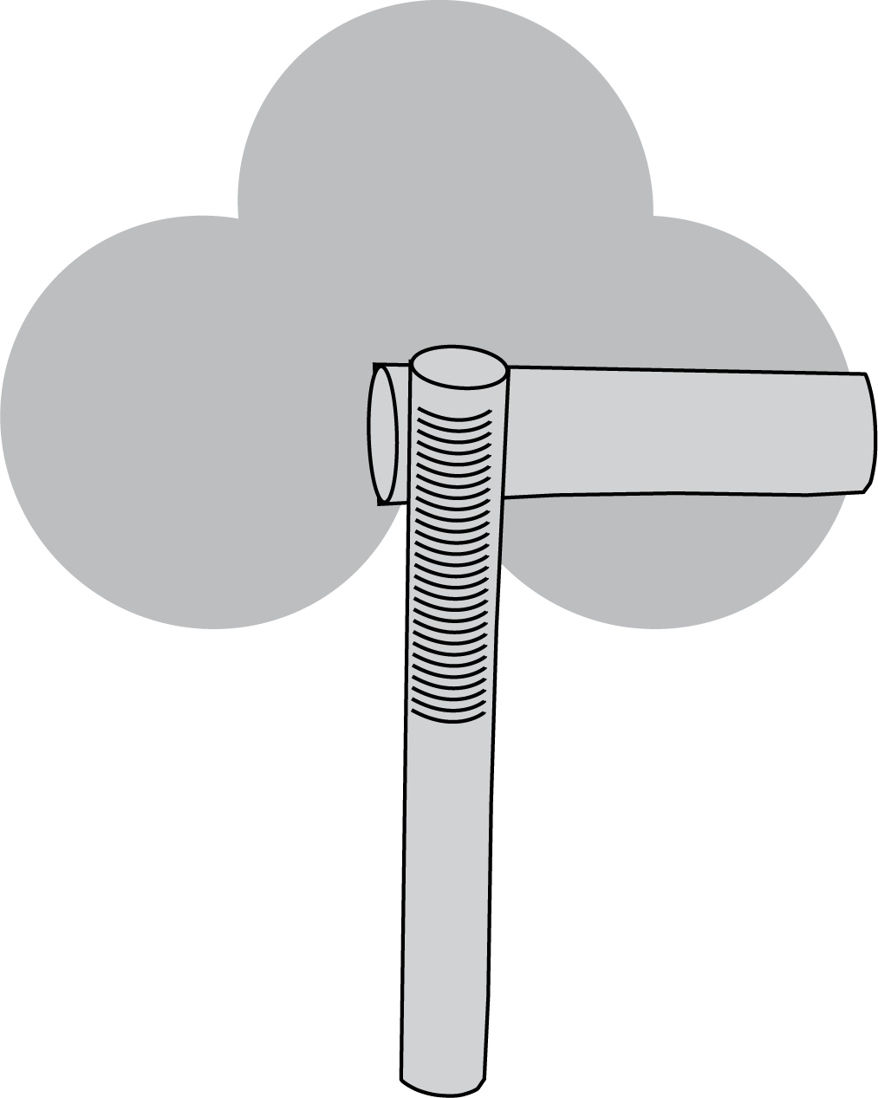
Stereo Recording: MS

Slide 29
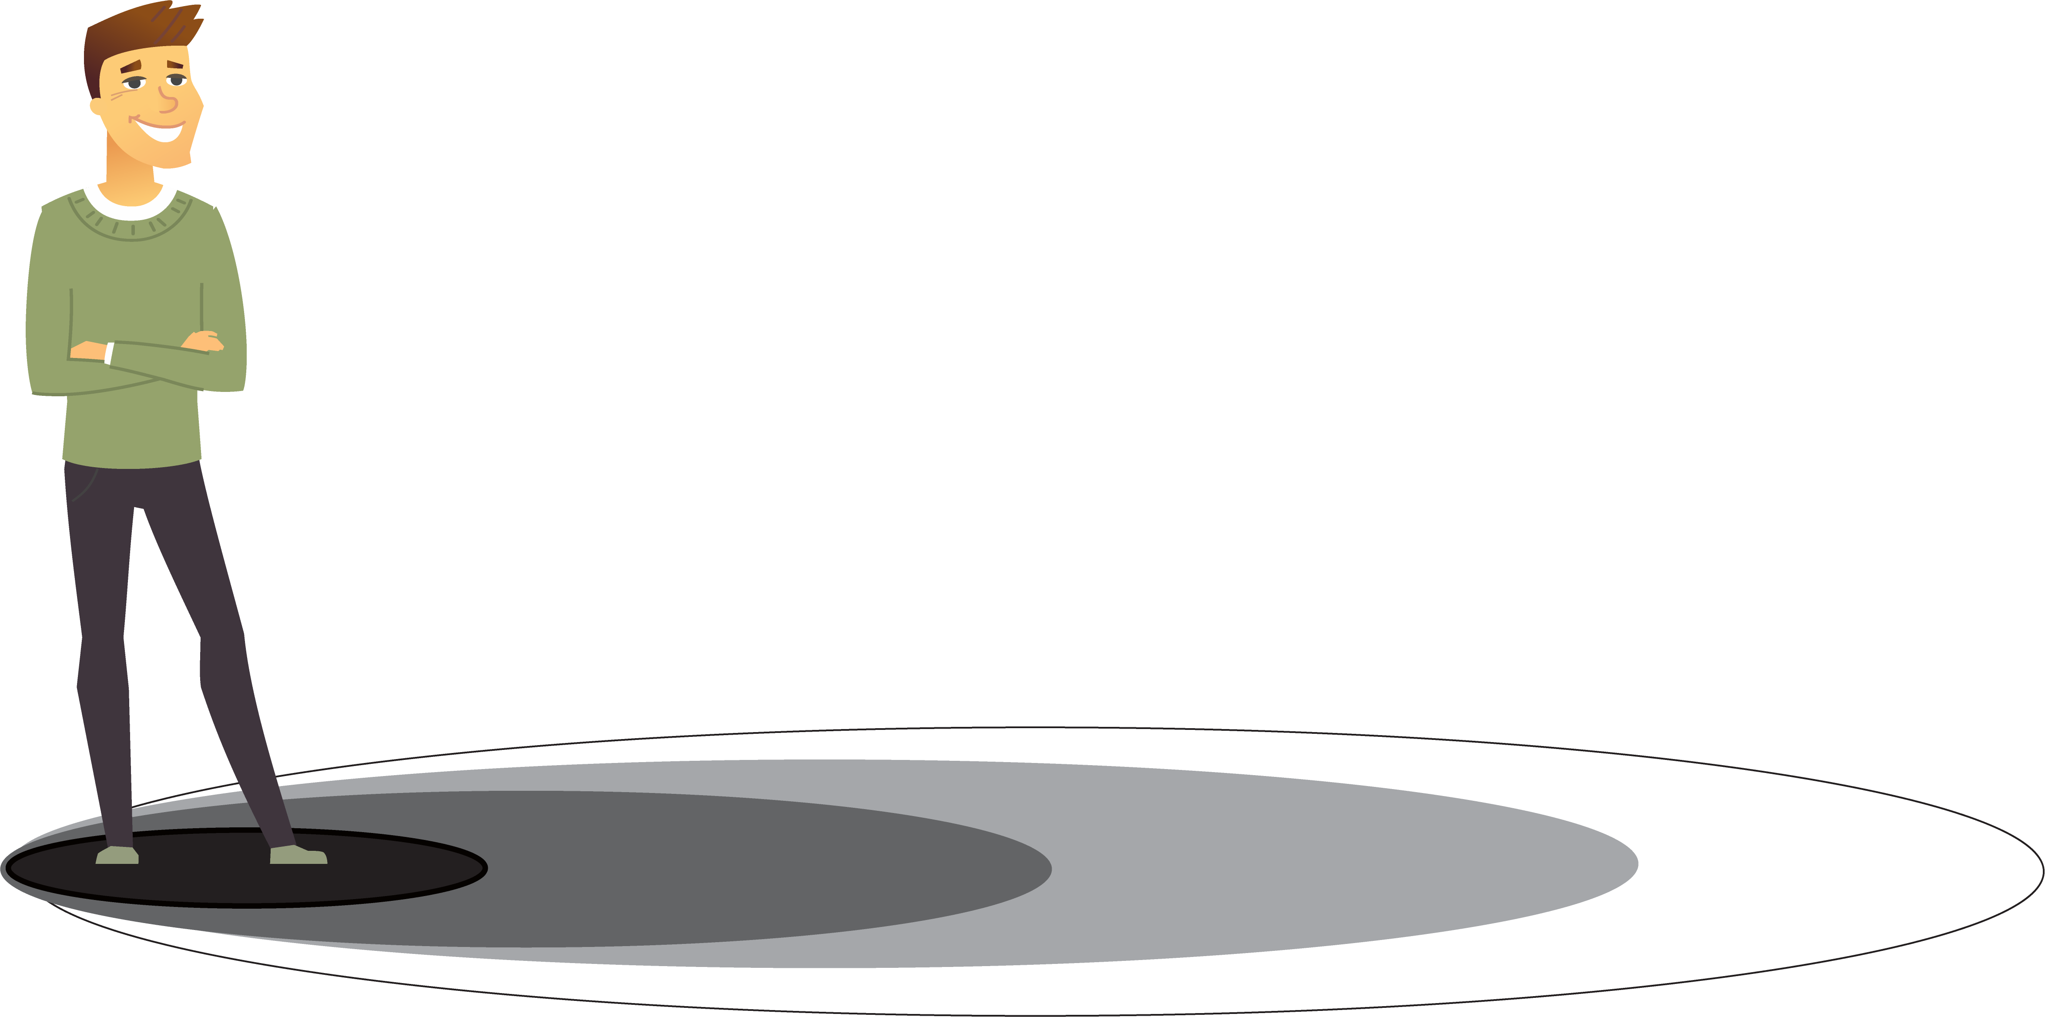
Proxemics
0 – 50 cm
.5 - 1m
1 - 4m
4m +
intimate
personal
social
public

