Slide 1
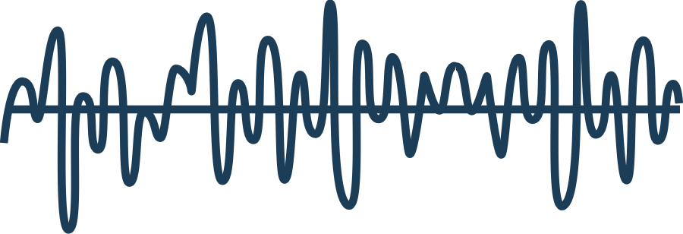
Chapter two
Sound

Slide 2
Outline
Sound Waves
Frequency
Consonance and Dissonance
Amplitude
Timbre
Wave Interference
Envelopes
Smearing, Rhythm and Masking
Sound Libraries & Copyright
Digital Sounds

Slide 3
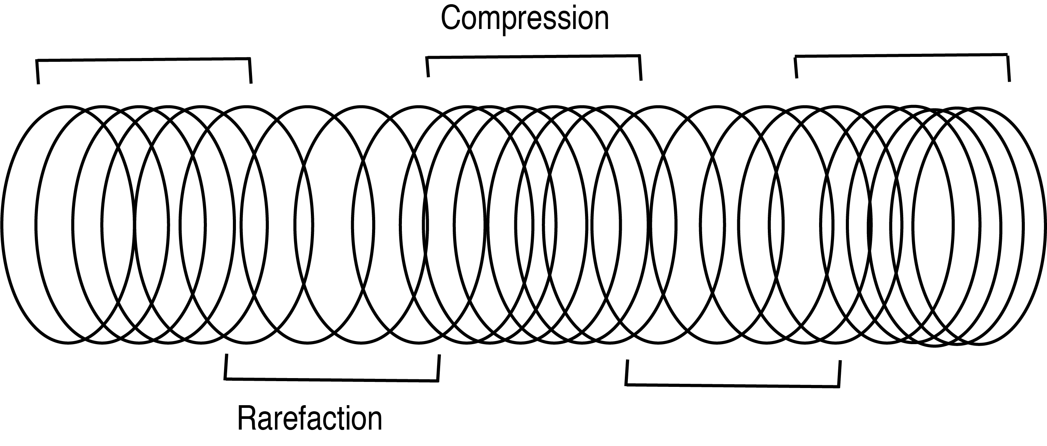
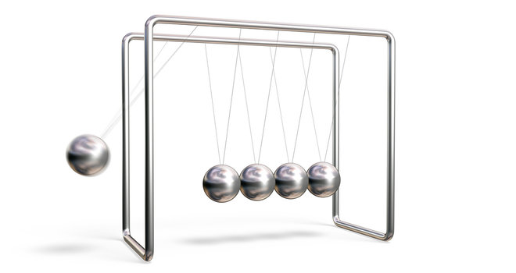
Longitudinal Waves
Compression and rarefaction
Wavelength: one compression and one rarefaction
Livescience.com: Newton’s Cradle

Slide 4
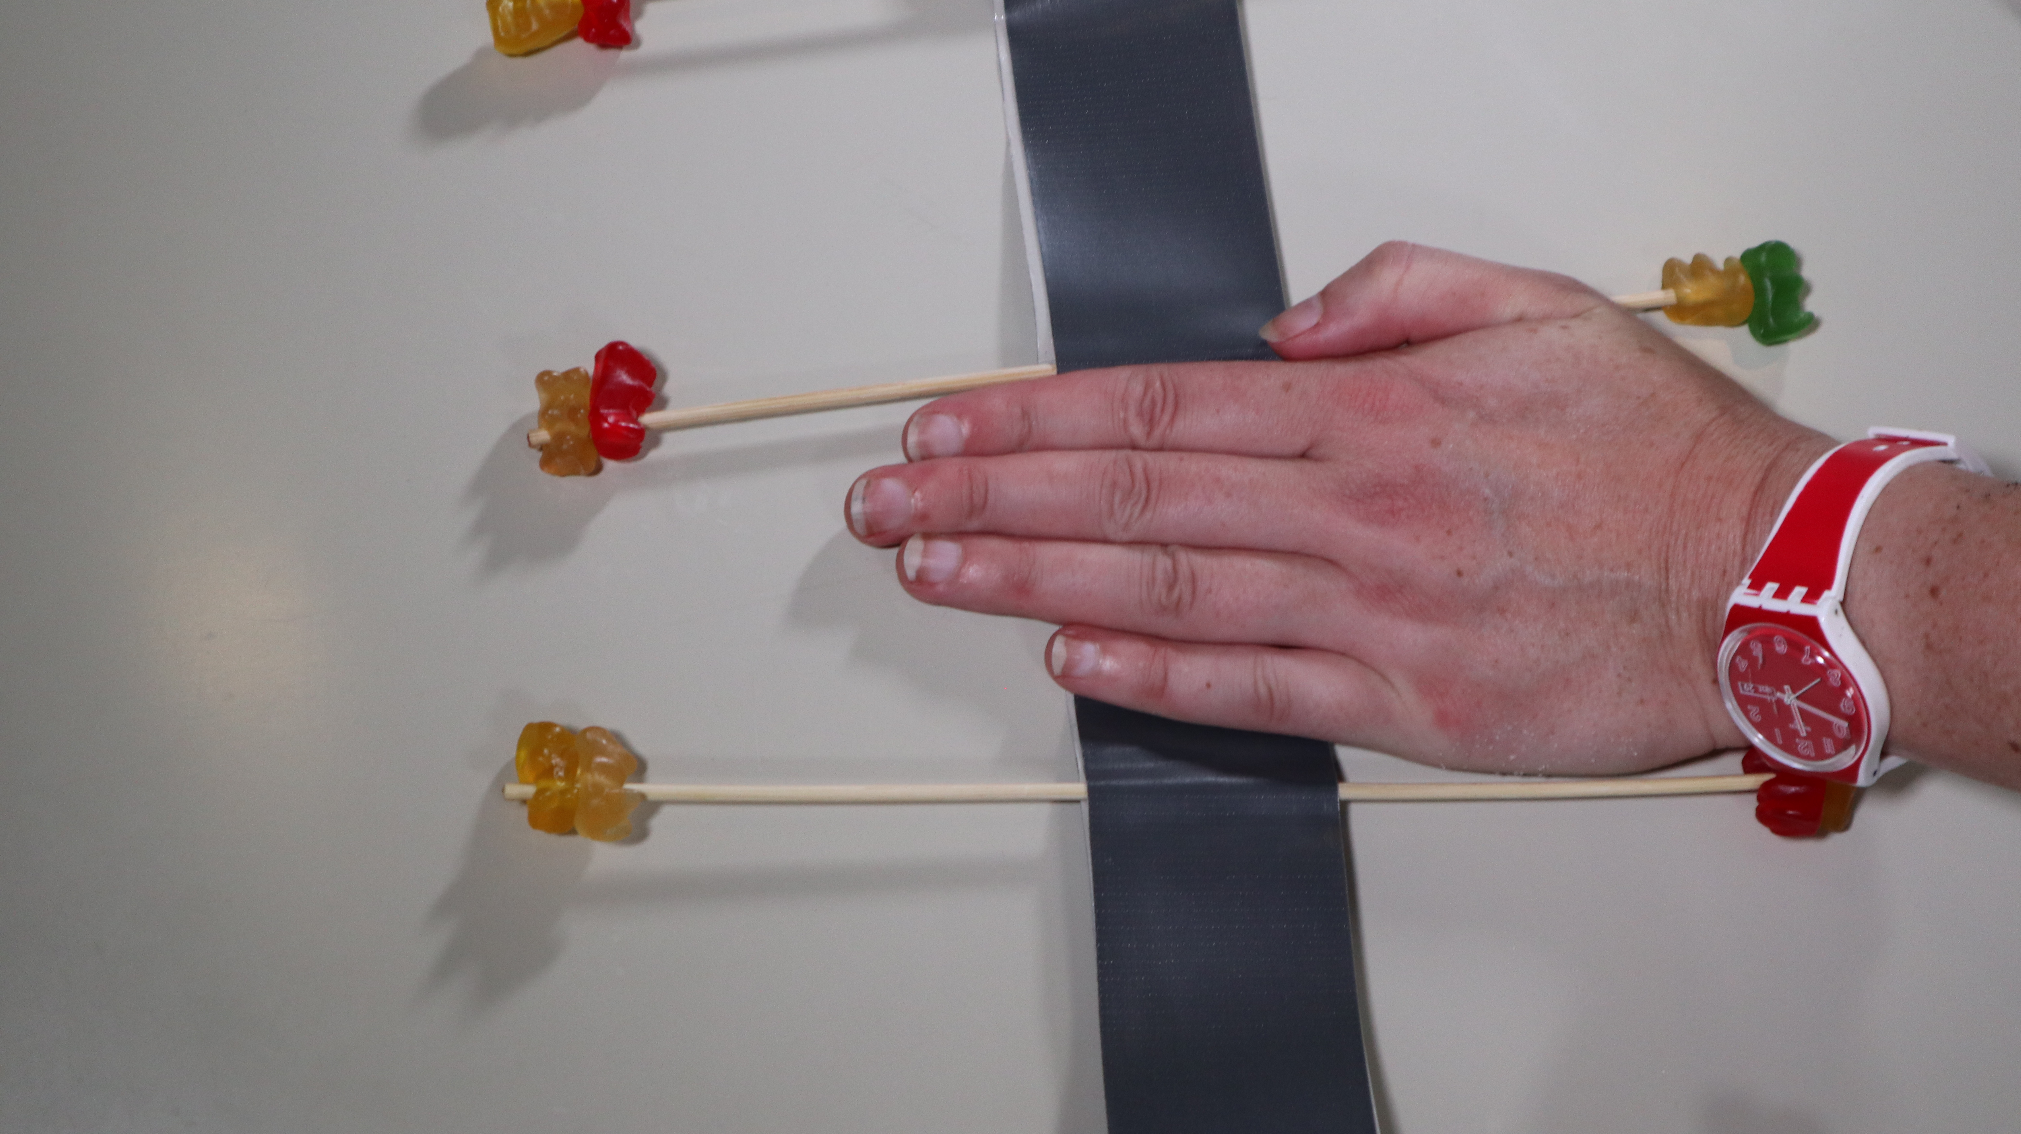
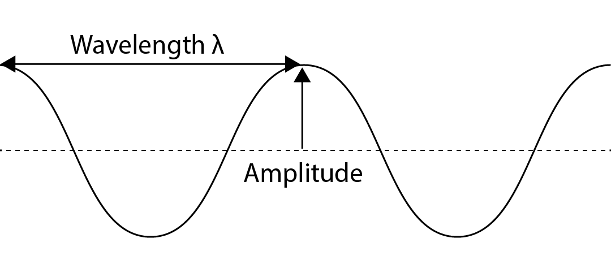
Transverse Wave model
Higher wave: more power = more amplitude
Faster wave = more frequent = higher frequency

Slide 5
Sound Wave in Audacity
Generate > Tone > OK
compression
rarefaction
One wave cycle

Slide 6
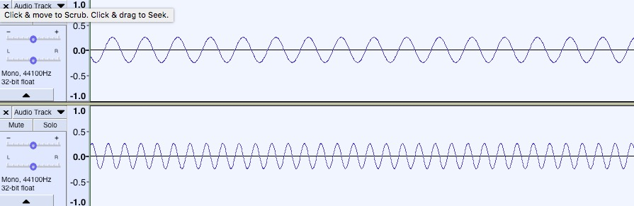
Frequency
Cycles per second = Hertz (Hz)
1000 Hz = 1 KHz
1 million Hz = 1 MHz
440 Hz and 880 Hz

Slide 7
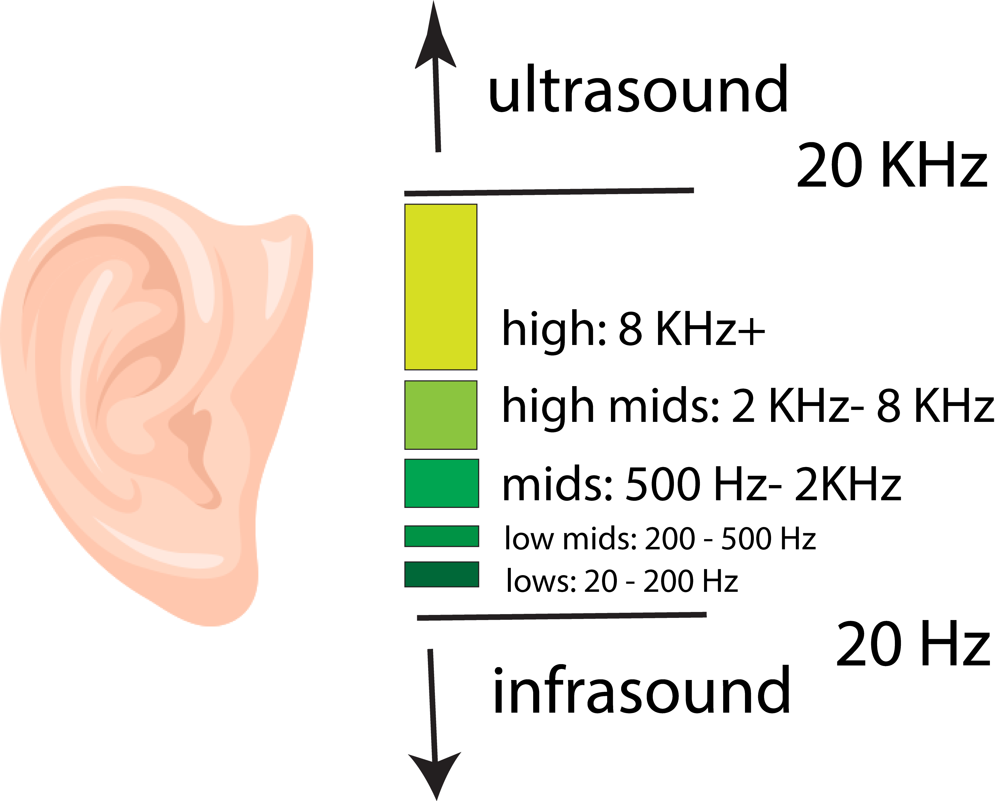
Refresher: Human Hearing and Frequency
Human hearing: 20 Hz to 20 KHz
Most in mids

Slide 8
Musical Instrument Frequencies
Instrument | Frequency Range
Piano | 28 Hz to 4186 Hz
Trombone | 82 Hz to 493 Hz
Kick Drum | 60 Hz – 150 Hz
Snare drum | 100 Hz- 6 KHz
Soprano singer | 262 Hz to 1050 Hz
Tenor singer | 240 Hz to 525 Hz
Bass Singer | 87 Hz to 330 Hz

Slide 9
http://homerecordingweekly.blogspot.com/2010/09/eq-for-mixing-purposes.html

Slide 10

Spectral Analysis
Analyze: Plot Spectrum

Slide 11
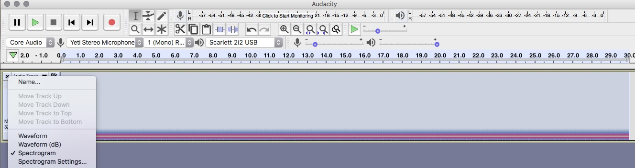
Spectrogram view

Slide 12
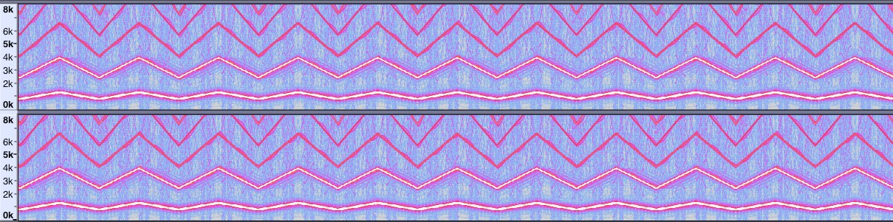
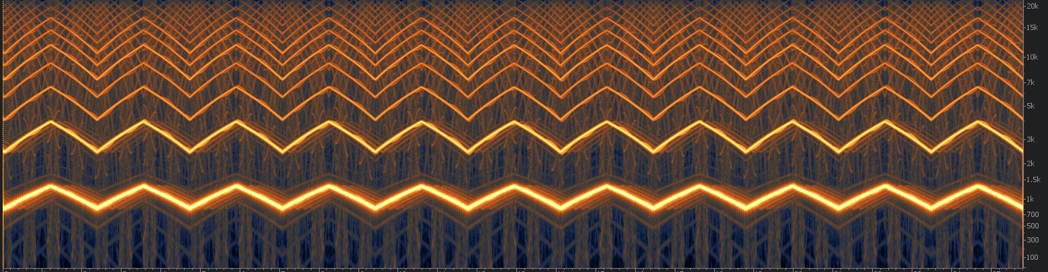
Siren in Audacity and RX

Slide 13
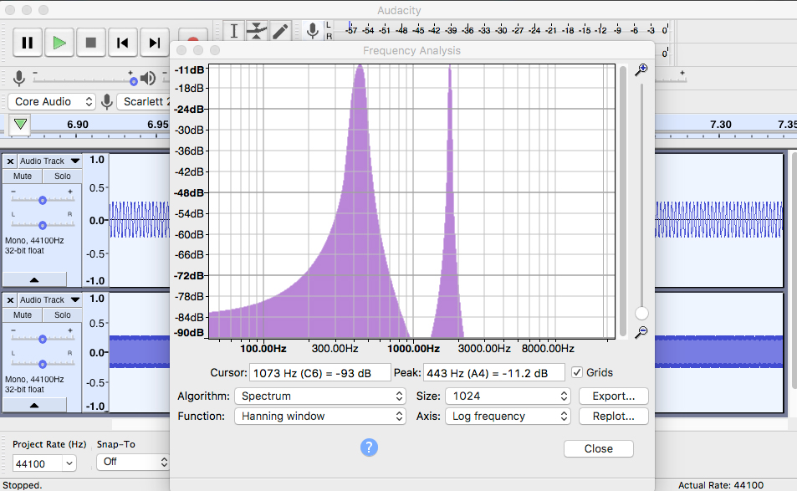
Plot Spectrum: 2 tones
Generate > Tone > 440 Hz
Tracks > Add New > Mono Track
Generate > Tone > 1760 Hz
Analyze > Plot Spectrum

Slide 14
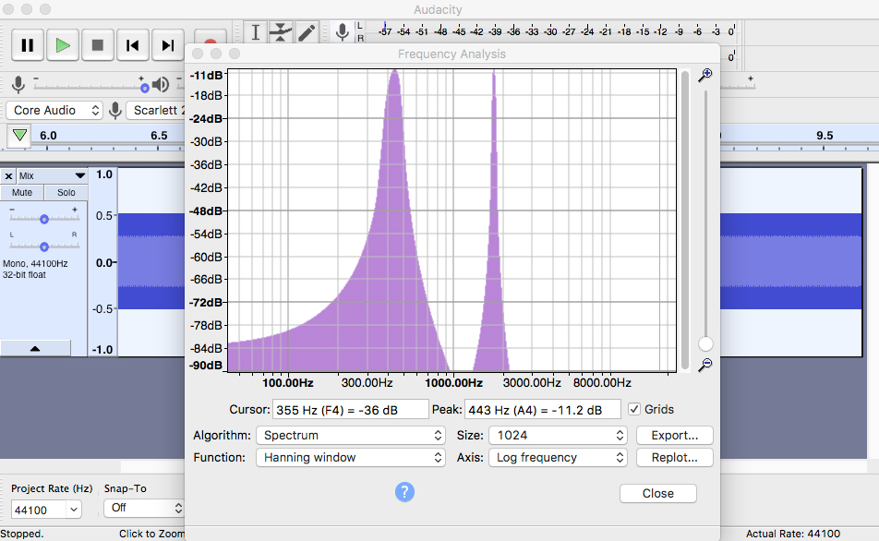
Mixing Frequencies
Effect > Amplify > reduce by 6 dB
Tracks> Mix and Render
Analyze > Plot Spectrum
Undo (Cmd/Ctrl Z). Delete track 2.
Generate > Tone > 1700 Hz.

Slide 15
Consonance and Dissonance
Generate > Tone > 440 Hz (A4)
Tracks > Add New > Mono Track
Generate> Tone > 466.16 Hz (A#4)
Tracks > Add New > Mono Track
Generate > Tone > 523.25 (C5)
John Williams, Jaws theme
https://www.youtube.com/watch?v=ZvCI-gNK_y4

Slide 16
Diabolus in Musica
“The Unsettling Sound of Tritones, The Devil’s Interval”
NPR, All Things Considered October 31, 2017
https://www.npr.org/2017/10/31/560843189/the-unsettling-sound-of-tritones-the-devils-interval
Frans Francken (1581- 1642), Death Playing the Violin. Wikimedia Commons

Slide 17
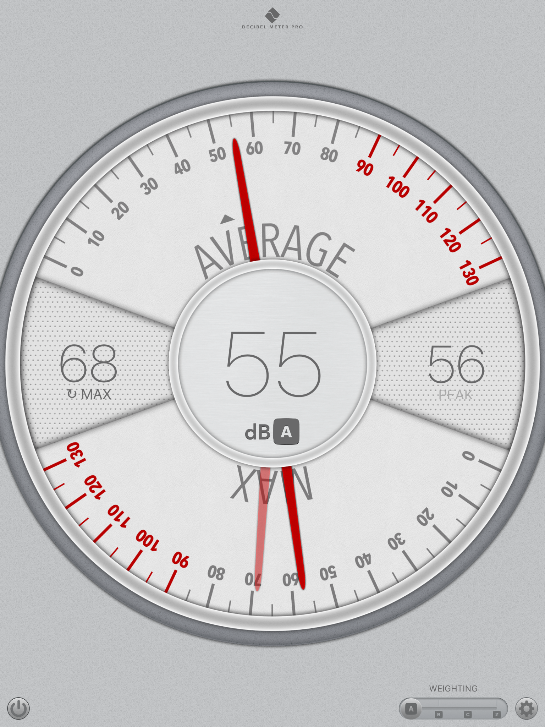
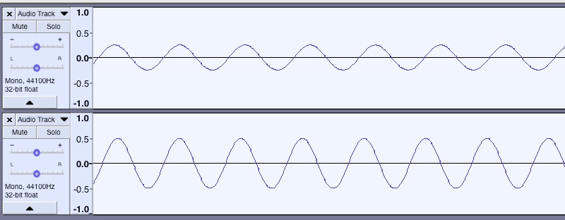
Amplitude
Height of wave
Pascals and Decibels (dB)
Effects> Amplify > +6 dB
Decibel Meter Pro, showing the current sound is 55 dBA

Slide 18
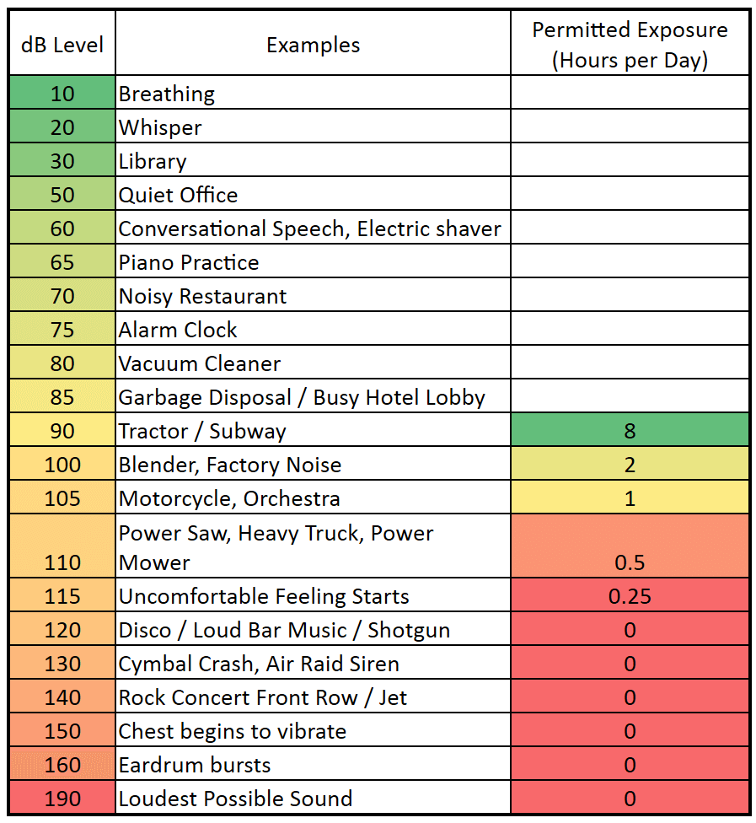
Amplitude And Hearing Refresher
Loudest Sounds:
Krakatoa 180 dB
Blue Whale 200 dB
Pistol Shrimp 200 dB
Earthquakes 250 dB
Tunguska Meteor 300 dB

Slide 19
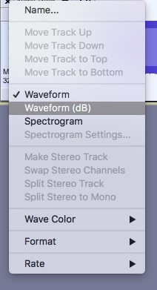
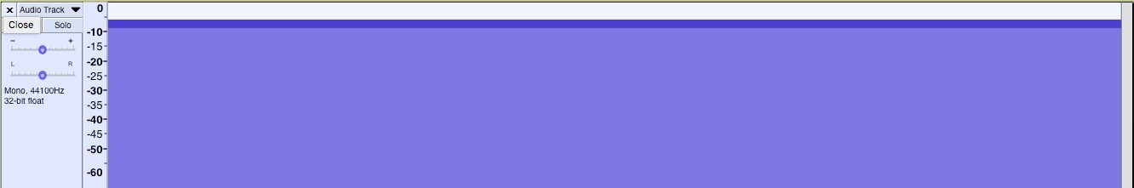

Digital Decibels…. dBFS

Slide 20
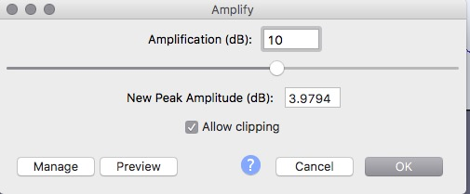
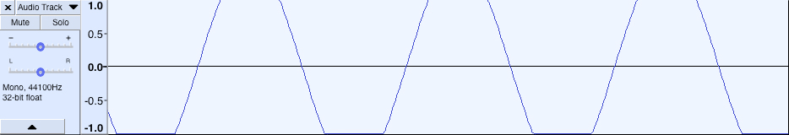
CLIPPING
Effect> Amplify > + 10 dB, Allow Clipping

Slide 21
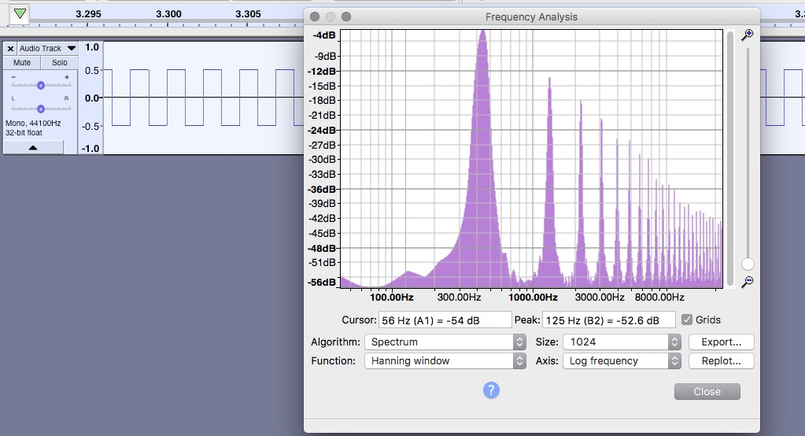
TIMBRE: HARMONICS
Generate> Tone > Square wave
Analyze > Plot Spectrum

Slide 22
Harmonics
Odd or Even
Ratio of Fundamental
https://www.electronics-tutorials.ws/accircuits/harmonics.html

Slide 23
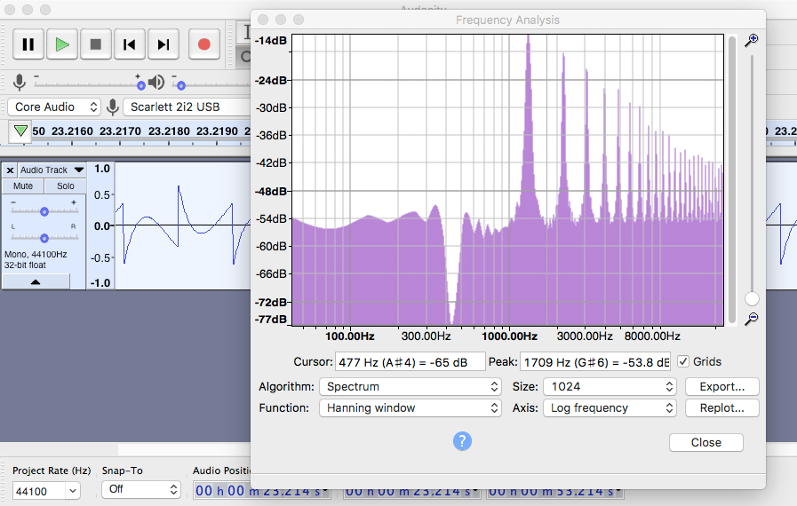
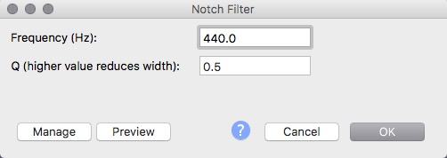


Phantom Frequencies
Generate > tone > square > 440 Hz
Effect > Notch Filter > 440 Hz

Slide 24
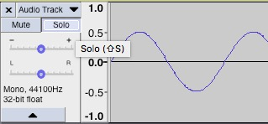
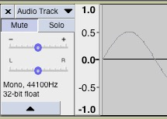


Combination Tones
Difference Tones:
(Sine wave)
Generate >Tone > 300 Hz
Generate > Tone > 1000 Hz
Generate > Tone > 1300 Hz

Slide 25
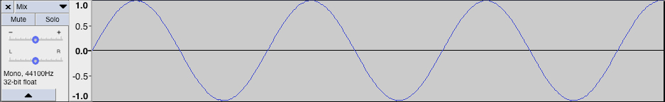
WAVE INTERFERENCE: Constructive
Generate > Tone > Sine wave at 0.5
Generate > Tone > Sine wave at 0.5
Tracks > Mix > Mix and Render

Slide 26
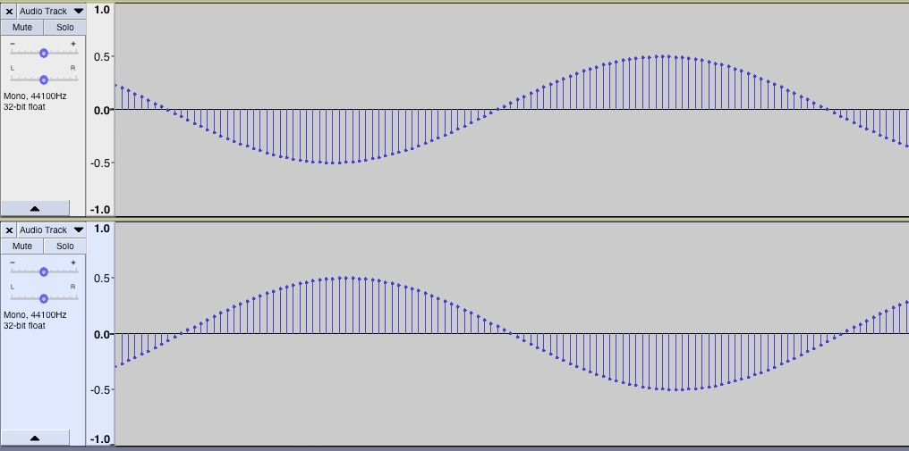
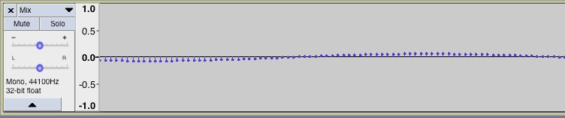




WAVE INTERFERENCE: Destructive
Generate > Tone > Sine wave at 0.5
Generate > Tone > Sine wave at 0.5
Shift second track ½ cycle
Tracks > Mix > Mix and Render

Slide 27
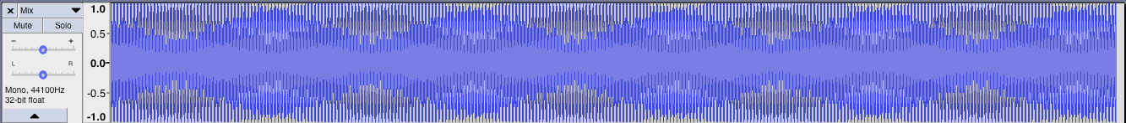
Binaural Beats
Constructive & Destructive Interference
Generate > Tone 200 Hz Generate > Tone > 202 Hz
Tracks > Mix > Mix and Render

Slide 28
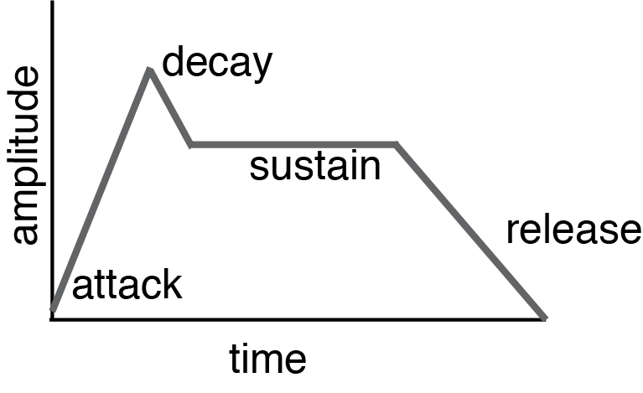
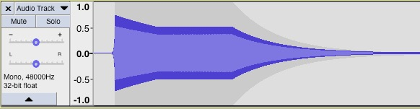

Envelopes
Attack: how quickly it reaches full volume
Decay: how quickly it drops to sustain
Sustain: constant amplitude
Release: how quickly sound fades away

Slide 29
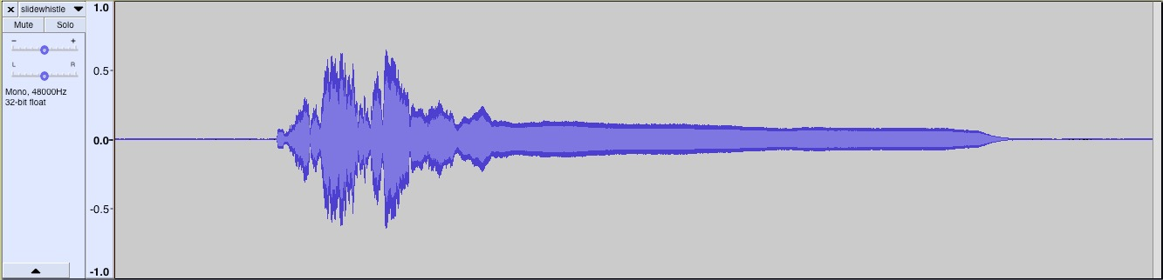
Sound Envelope: Slide Whistle

Slide 30
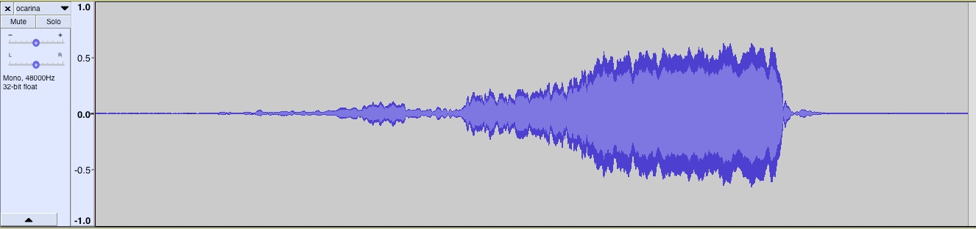

Sound Envelope: Ocarina

Slide 31
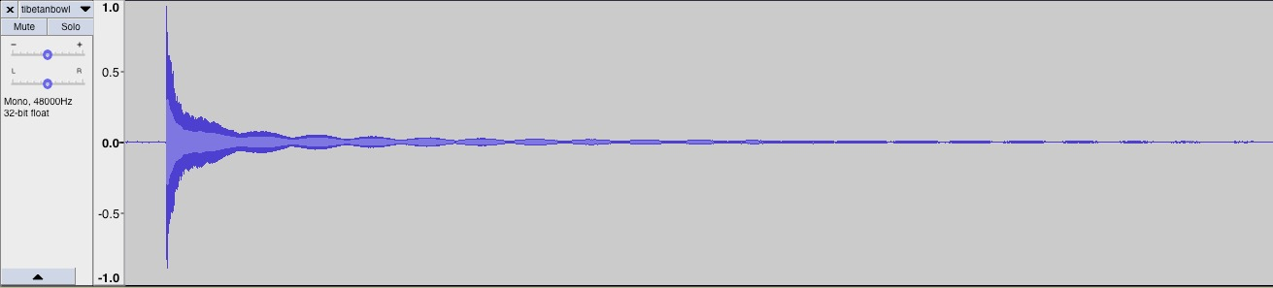
Sound Envelope: Tibetan Bowl

Slide 32
Exercise #2.11 Reverse Envelopes
Reverse a few sounds (Effect > reverse) and note how the envelope of the sound changes. How would you describe the sound you hear now?

Slide 33

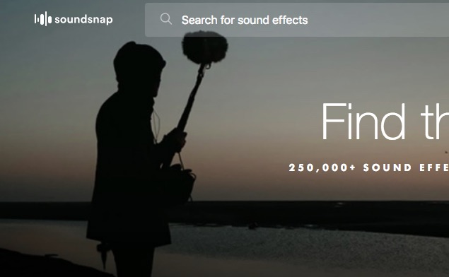
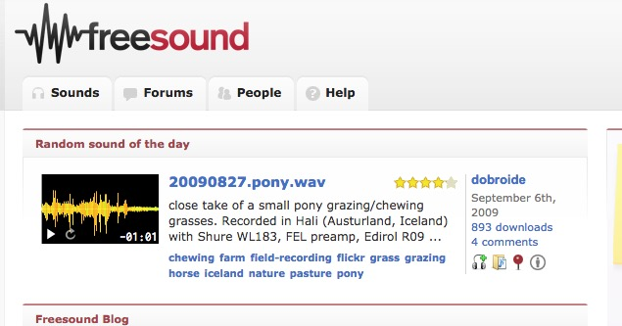
SOUND LIBRARIES

Slide 34
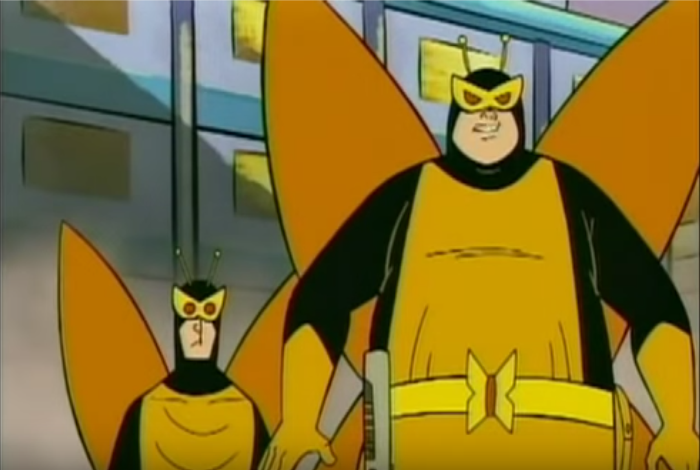
The Wilhelm Scream
https://www.youtube.com/watch?time_continue=1&v=4YDpuA90KEY
https://www.youtube.com/watch?time_continue=1&v=4YDpuA90KEY

Slide 35
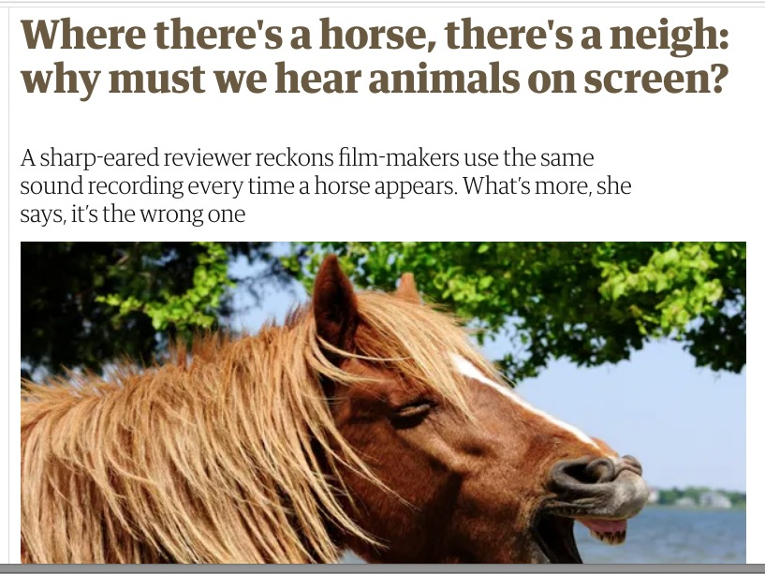
Sound library samples
Read the article: https://www.theguardian.com/tv-and-radio/shortcuts/2019/jan/04/where-theres-a-horse-theres-a-neigh-why-must-we-hear-animals-on-screen
Discussion: Is it important to have our own sounds? Why or why not?

Slide 36
SOUND CATEGORIES
Ambience
Spot/One-shots
Foley
Designed Sounds
How did YOU categorize sounds?

Slide 37

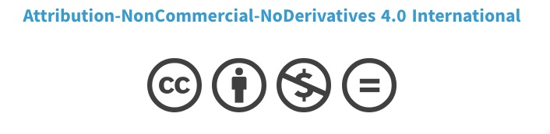
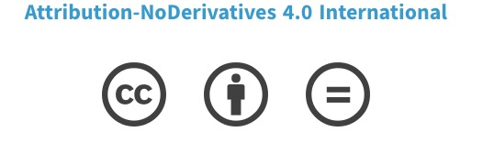
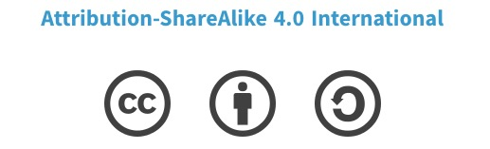
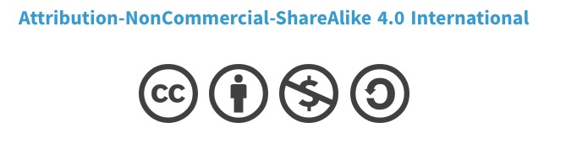
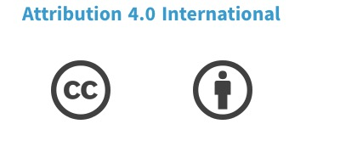
COPYRIGHT

Slide 38
TRACKING YOUR USE OF SAMPLES
Filename | Source | License
acceleration.wav | https://freesound.org/s/179940/ | Attribution
footsteps.wav | https://freesound.org/s/460083/ | Attribution non-commercial

Slide 39
Exercise # 2.17 Find a sound like…
Oof
Pop
Bang
Whoosh
Swish
Glug

Slide 40
Exercise #2.18 Opposites attract
Find two sounds that appear to be opposites or contrast each other. You can do this with a partner, and one finds a sound and the other finds its opposite. What aspect(s) did you choose to oppose (amplitude? Frequency?)

Slide 41
DIGITAL SOUNDS
Pulse Code Modulation (PCM)
Quantization
Sampling

Slide 42
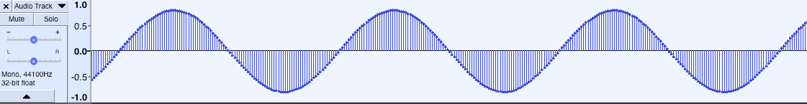
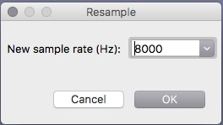
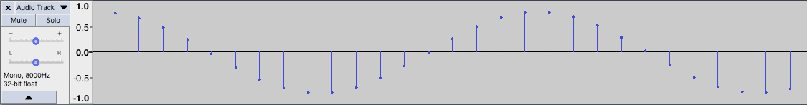
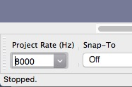
Sample Rate
Tracks > Resample > 8000 Hz

Slide 43
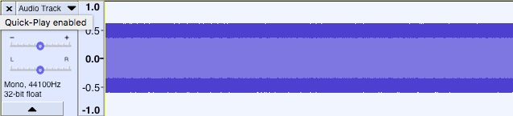
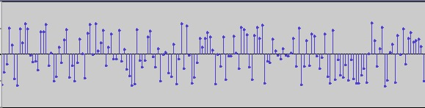
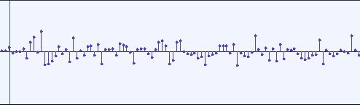
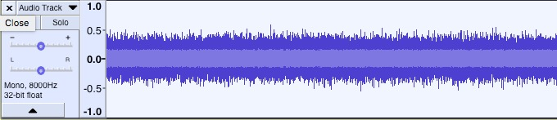

Noise at 44.1 and 8 KHz
Generate > Noise > White
Tracks > Resample > 8000 Hz

Slide 44

Bit Depth
https://thehub.musiciansfriend.com/tech-tips/sample-rate-and-bit-depth-an-introduction-to-sampling
wikipedia

Slide 45


Bit Depth: Spectral Analysis in Audition
Why is the spectrum on the 8-bit version more grainy?
24-bit
8-bit

Slide 46
Bit Rate
Measured in Kilo-Bits per second (kbps)
Lossless = 1411 kbps
Spotify Streamed audio = 96 kbps (phones), 160 kbps (desktop)
 | CD audio | DVD audio
Sample rate | 44.1 KHz | 192 KHz
Bit rate | c. 1.5 Mbps | 5 Mbps
Bit depth | 16-bit | 24-bit

Slide 47
Can you hear the difference?
A/B/X Tests:
http://abx.digitalfeed.net/#numTrials/5/sample/0
http://www.mp3ornot.com/

Slide 48
Lossless & Lossy Formats
LOSSLESS
No compression
E.g. .WAV, .FLAC
4 minute song ~ 40 MB
LOSSY
Varying compression amounts
E.g. MP3, M4A, OGG, AAC
4 minute song ~ 4MB+

