Slide 1

Chapter One
Listening and Hearing

Slide 2
Contents
Hearing and Listening
Talking and writing about sound
Bone Conduction
The Ear
Protecting Your Hearing
Headphones Guide

Slide 3
HEARING AND LISTENING
What is the difference between hearing and listening?
Can we train ourselves to listen?

Slide 4
Exercise #1.1: Quiet Time
Try standing up from your chair without making any sound.
How was the process of listening different from how you normally hear sound?

Slide 5
Talking and Writing About Sound
What type of language do we have to talk about sound?
What words do we use to describe sound?

Slide 6
Exercise #1.2 Describing Sound
Take 5 Minutes & sit quietly somewhere
Write down all the sounds you hear

Slide 7
Exercise #1.2 Describing Sound Part 2
How did you describe the sound?
Causality: what made the sound?
How descriptive did you get?

Slide 8

Exercise #1.2 Describing Sound Part 3
Onomatopoeia: a word formed from the description of the sound it makes
What onomatopoeia did you use?

Slide 9
Exercise # 1.3 Gerald McBoingBoing
Watch the cartoon (or read the book)
How many onomatopoeia words can you think of?
Write an entire day’s journal entry just in onomatopoeia

Slide 10
How we think about and talk about sound
Sound libraries: How do sound libraries categorize sounds?
How else might we categorize sound?
What impact does categorizing have on our creativity?

Slide 11
Exercise #1.4 Categorizing sound
Categorize your list of sounds in different ways, e.g.
natural --- human-made
pleasant --- unpleasant
quiet --- loud
rough --- smooth
?? --- ??

Slide 12
Exercise #1.5 The Sound Walk
Have someone guide you blindfolded for a short walk. Focus on the sounds you hear.
Make a sound you can repeat in different spaces (like a hand clap). How does it change in different places?

Slide 13
Critical Listening: The Sound walk
Hildegard Westerkamp on The World Soundscape Project on North by Northwest, CBC Radio April 15, 2018
https://www.cbc.ca/radio/ideas/how-opening-our-ears-can-open-our-minds-hildegard-westerkamp-1.3962163

Slide 14
Soundscapes & Acoustic Ecology
What does it mean to record our soundscape?
Should we bother preserving the sounds of our world? Why or why not?
What can we learn by listening to soundscapes?

Slide 15
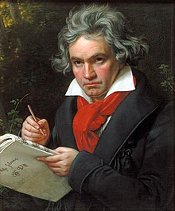
BONE CONDUCTION
Sound vibrations in bones picked up by brain
Beethoven (1770 - 1827) used wooden rod to hear after losing hearing
Image: GameOnMom.com
Beethoven painting by Stieler, 1820

Slide 16
Exercise #1.12: Bone Conduction with Dowel
Get 3mm (or ¼”) wooden dowel, about 40 cm long (15”).
Plug your ears with fingers or plugs
Bite on one end, and put the other end on something making sound.

Slide 17
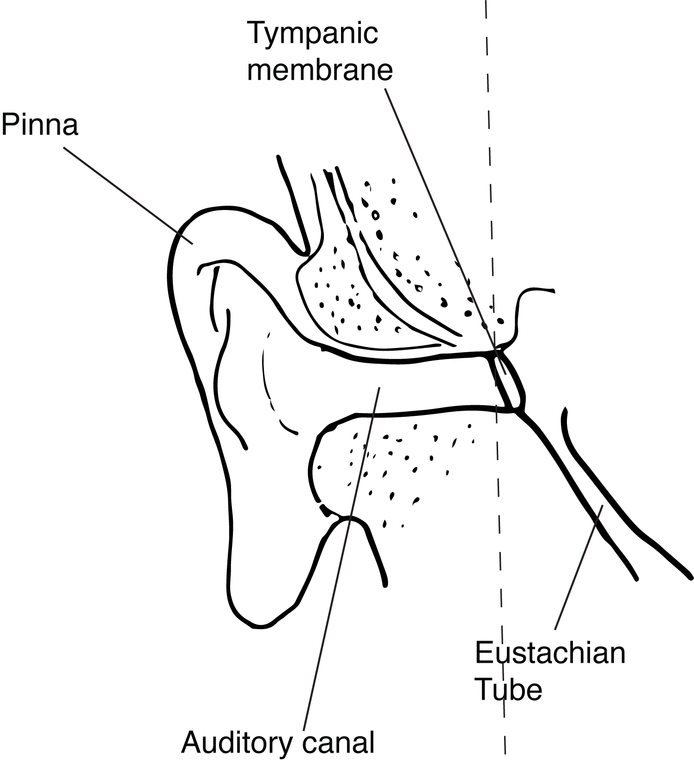
THE EAR -- Outer
Pinnae- unique - ear prints
Auditory canal
Ear drum- tympanic membrane

Slide 18
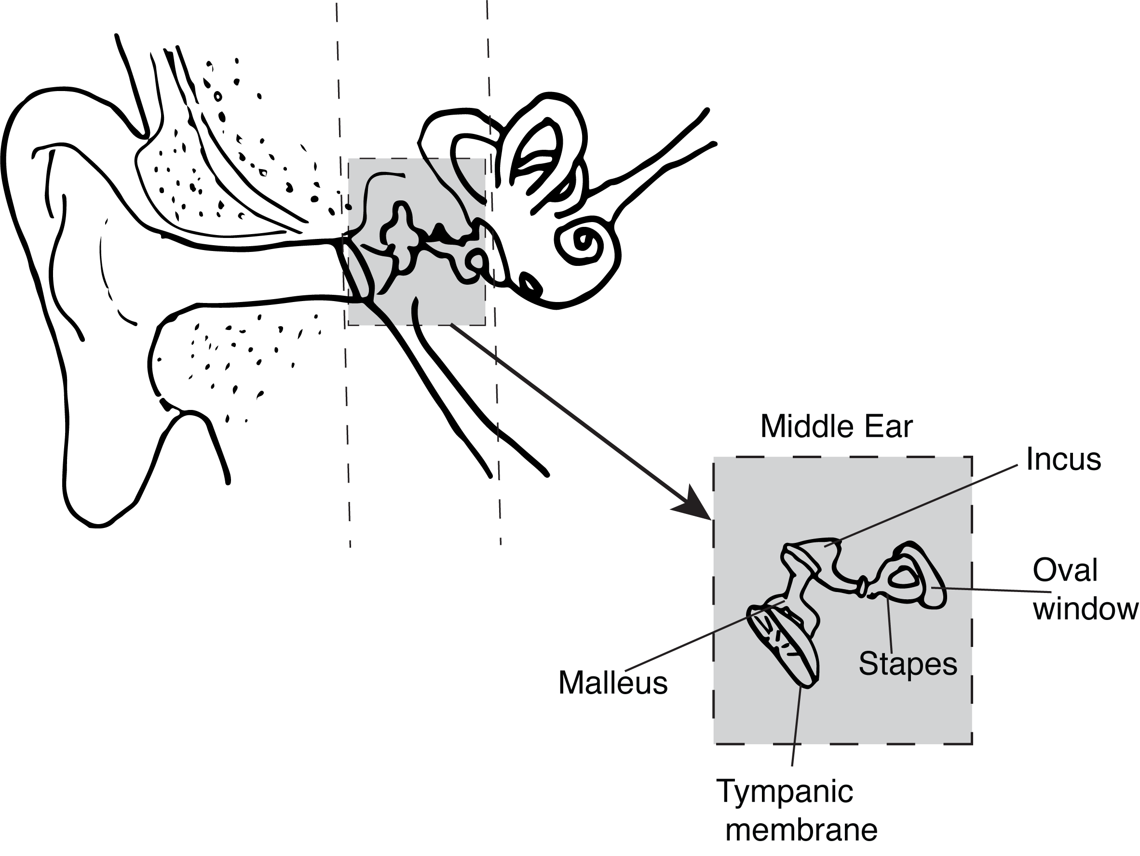
THE EAR -- Middle
Tympanic cavity
The Ossicles:
Malleus (hammer)
Incus (anvil)
Stirrup (stapes)
Oval Window
Eustachian Tube – connects to throat

Slide 19
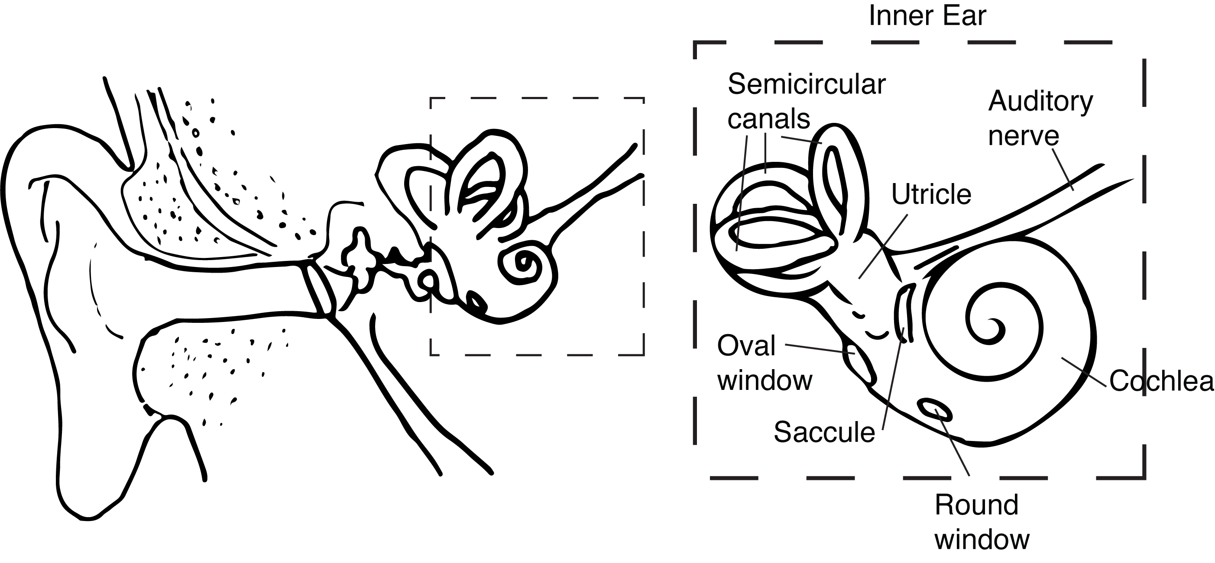
THE EAR -- Inner
Semicircular canals
Cochlea
Auditory Nerve

Slide 20
The Cochlea
Cilia specific to frequency
Send signal via the auditory nerve to brain
https://fonoaudiologos.wordpress.com/2012/09/29/frecuencias-en-la-coclea/

Slide 21
Hearing and the Senses: Exercise #1.14
Write in your journal what it must be like for a baby hearing sound from the womb. What sounds would they not be able to hear because of the muffled barrier of the womb? What sounds would they hear more loudly because of where they are?

Slide 22
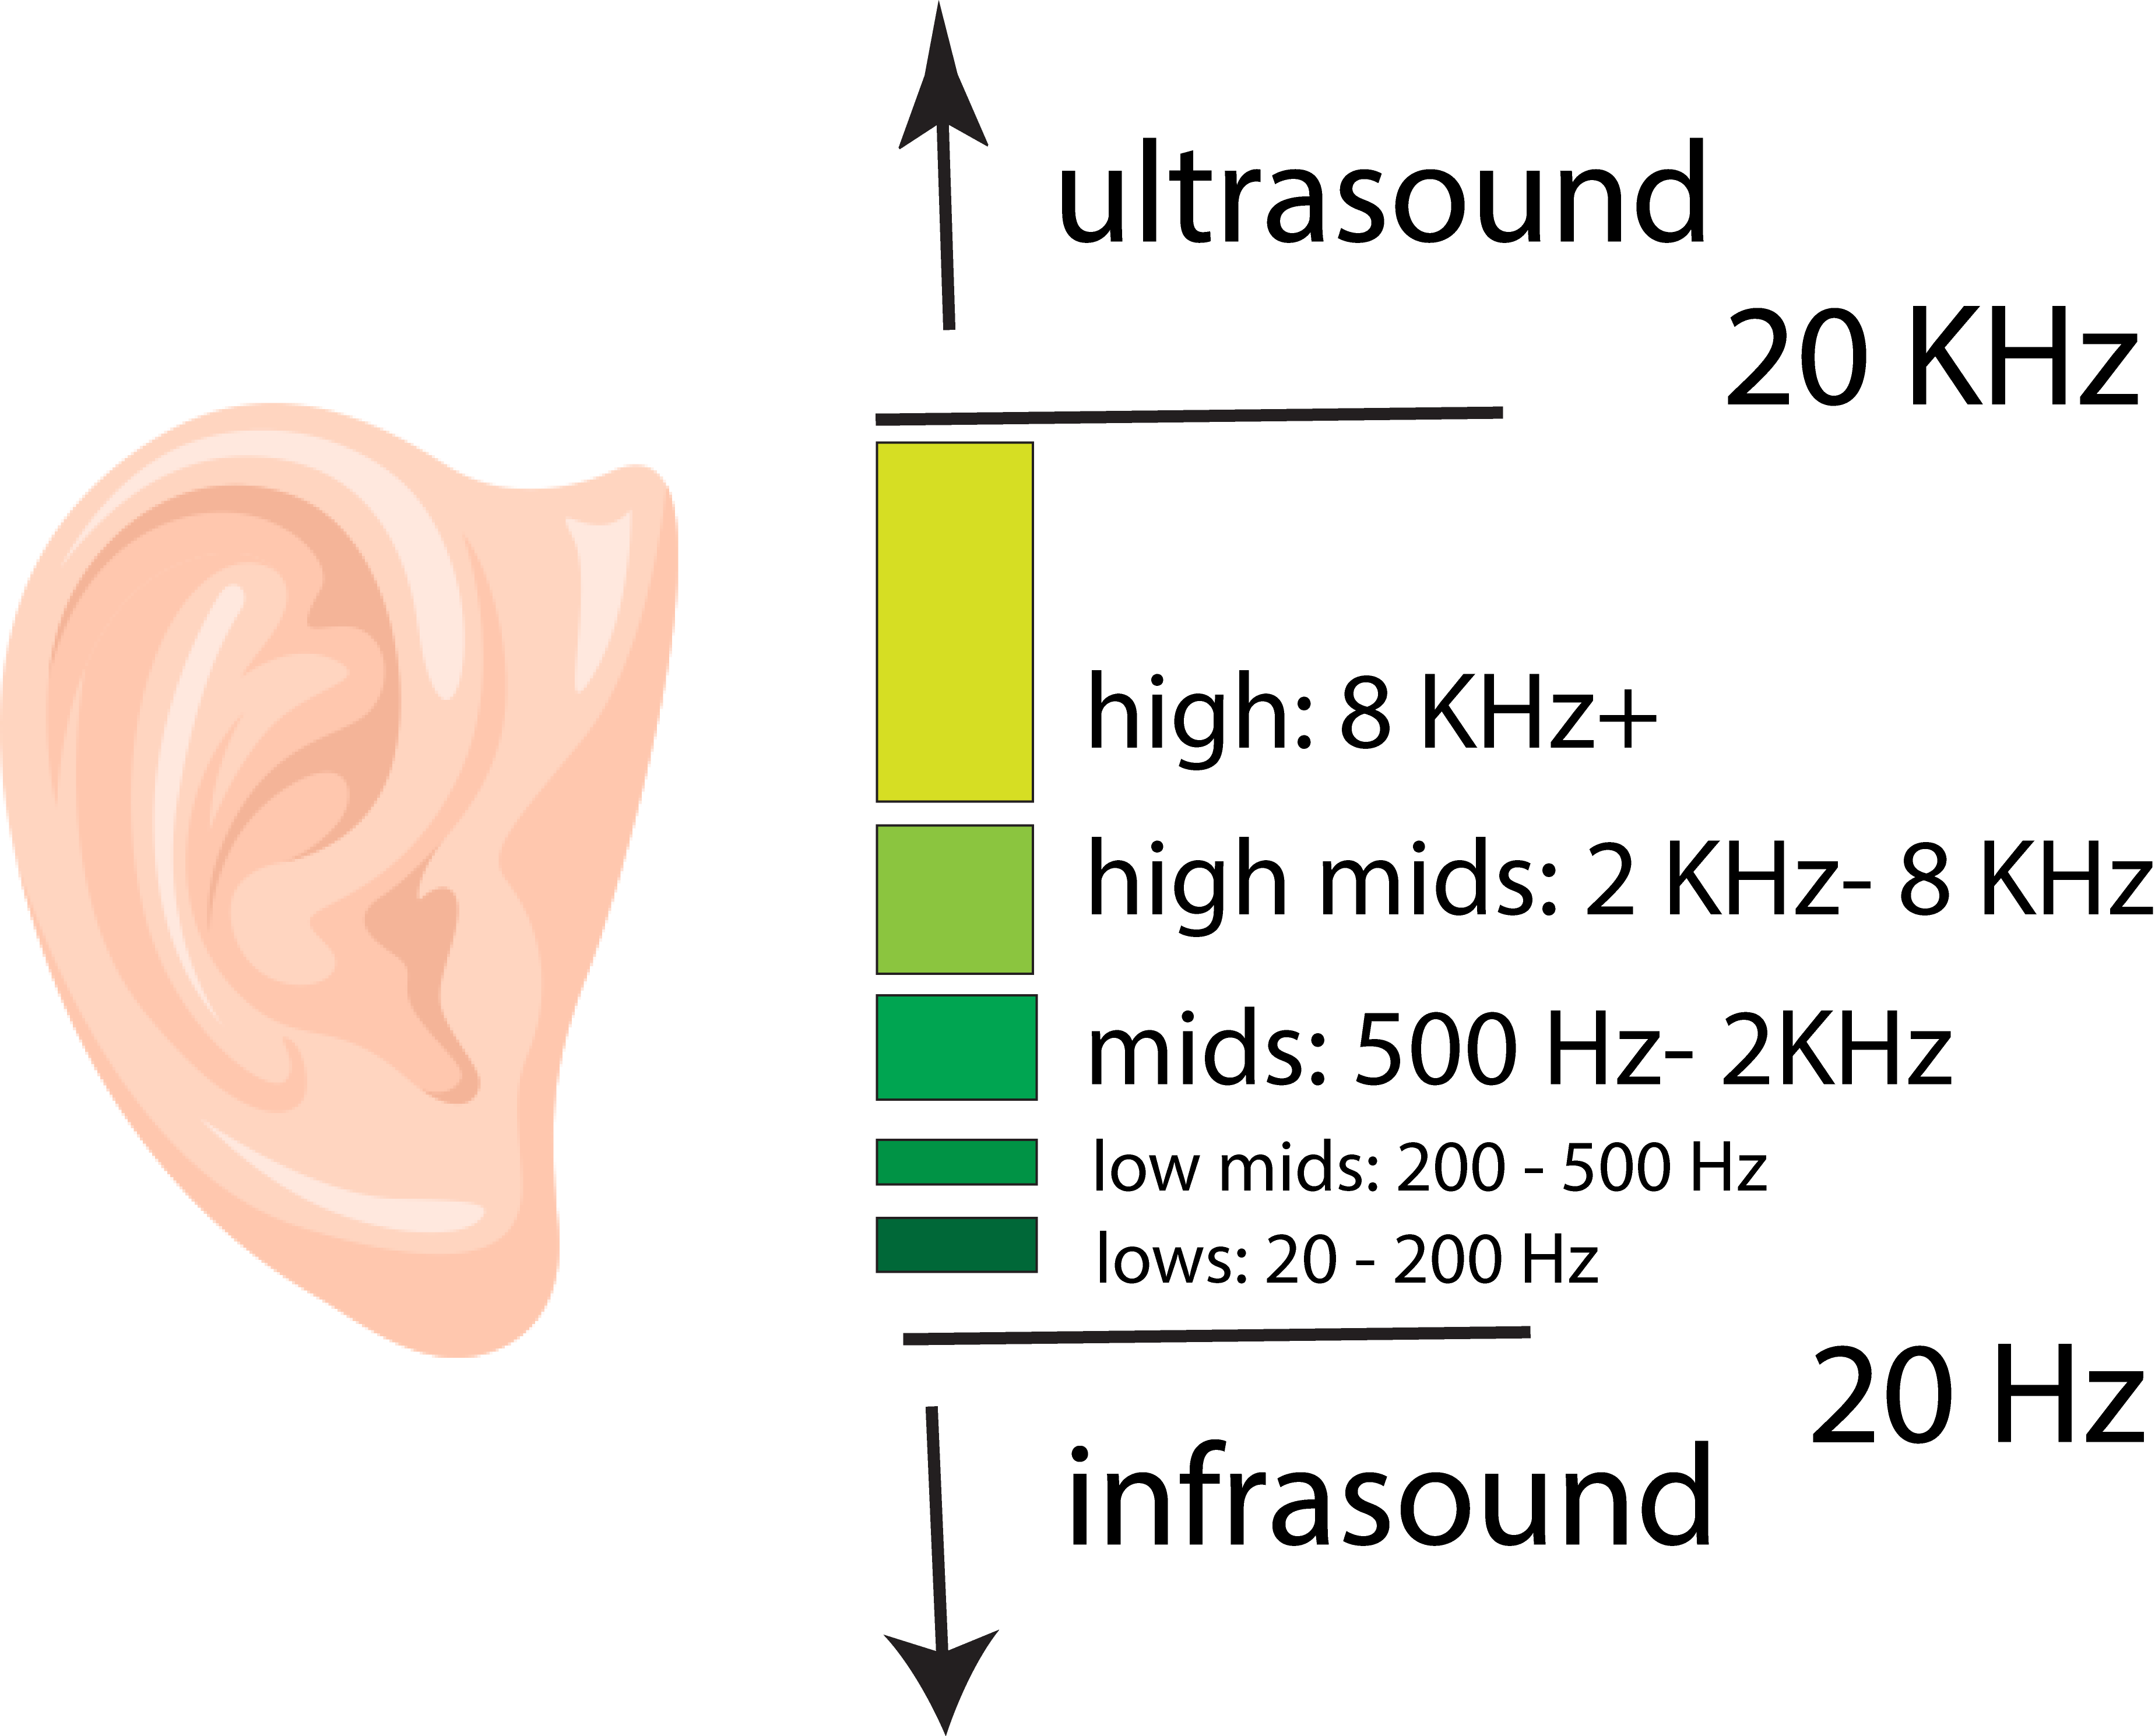
HUMAN HEARING ABILITY
20 Hz – 20 KHz
Age-Related Hearing Loss:
  “Mosquito” tone
Tone Generator: *(link)

Slide 23
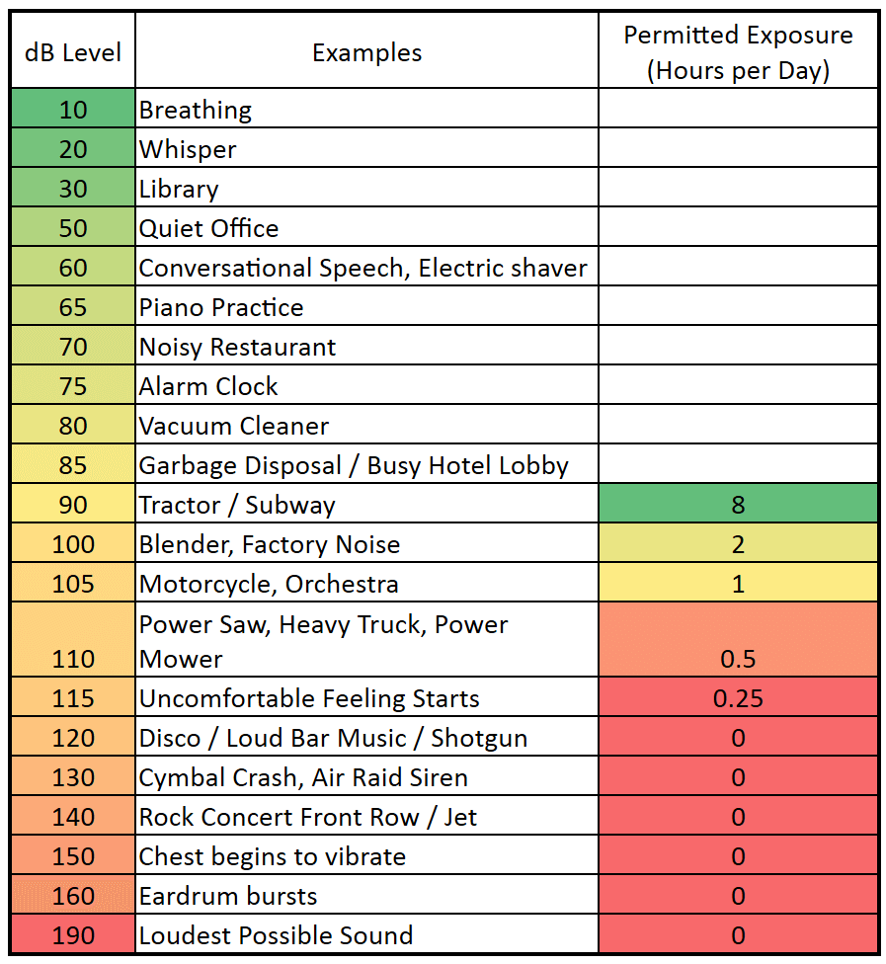
HUMAN HEARING ABILITY
80 dB long-term = damage
90 dB short-term damage
115 dB very short sound = permanent damage
https://boomspeaker.com/noise-level-chart-db-level-chart/

Slide 24
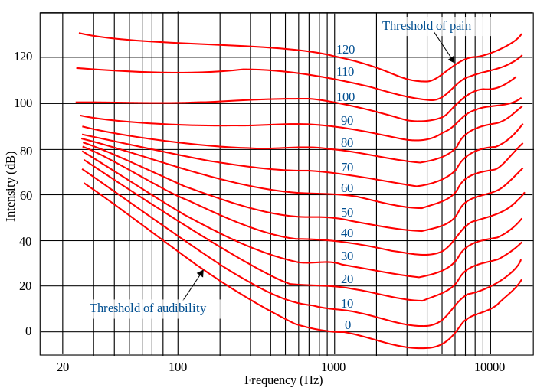
Equal Loudness: Fletcher-Munson Curves
https://www.kmuw.org/post/loudness-and-fletcher-munson-curve

Slide 25
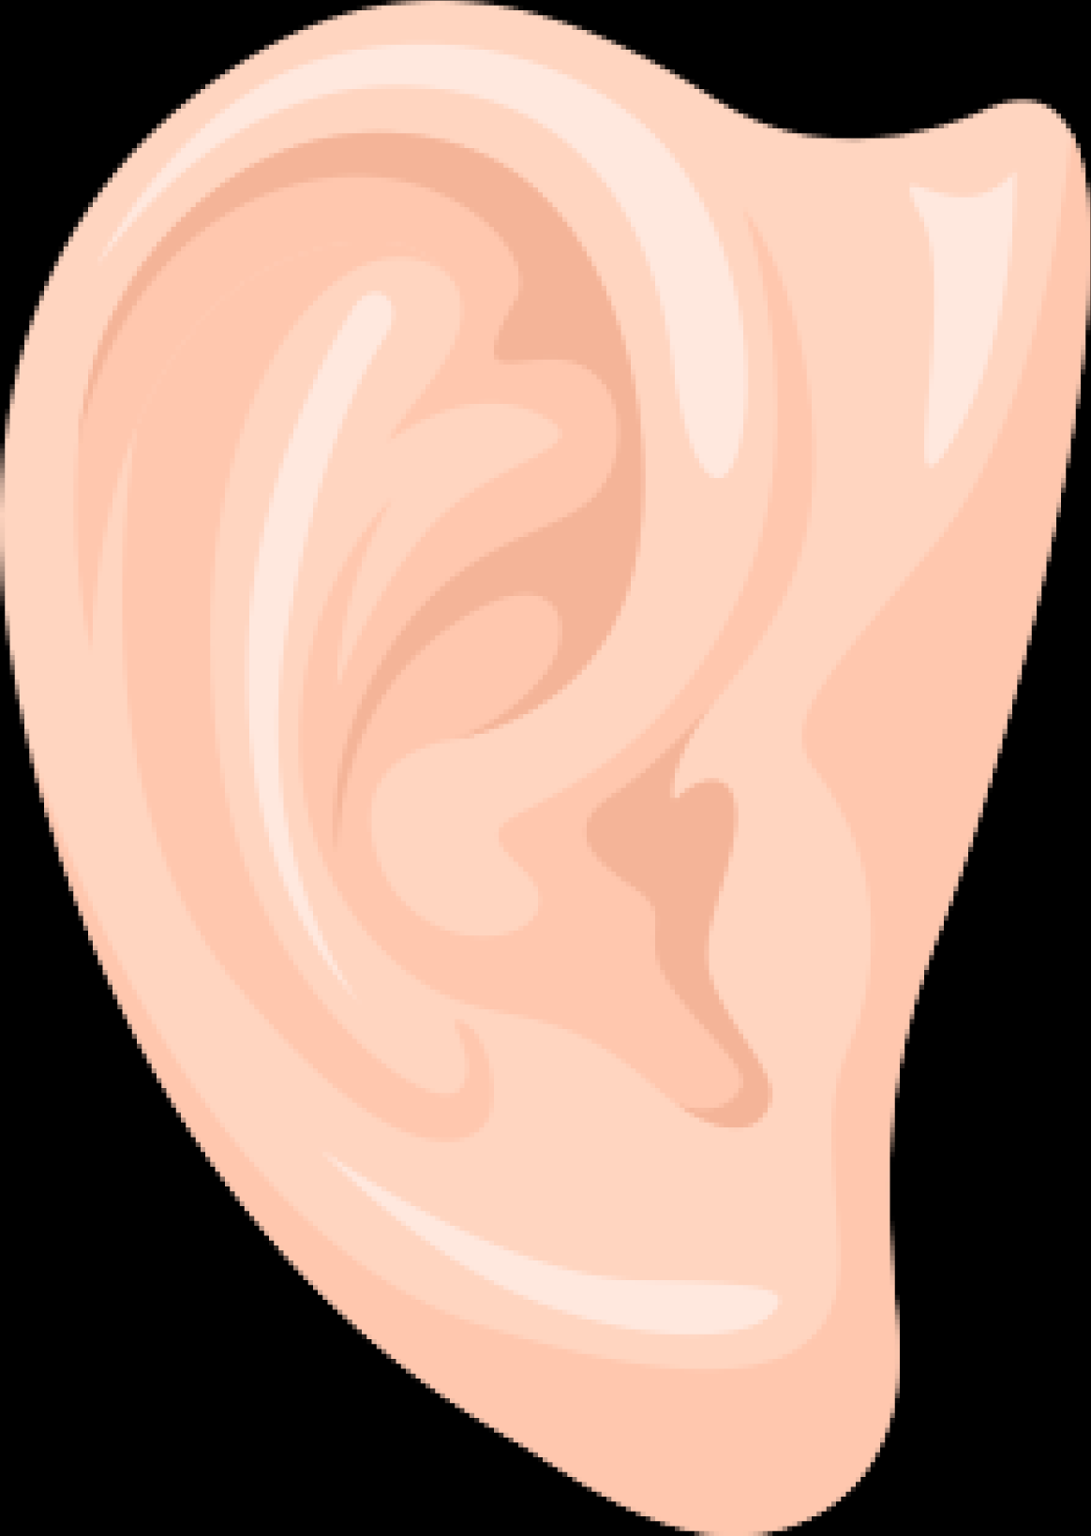

Protect Your Hearing
  Noise
  Cotton buds
  Cold
  Medications
  Tinnitus = sign of damage

Slide 26

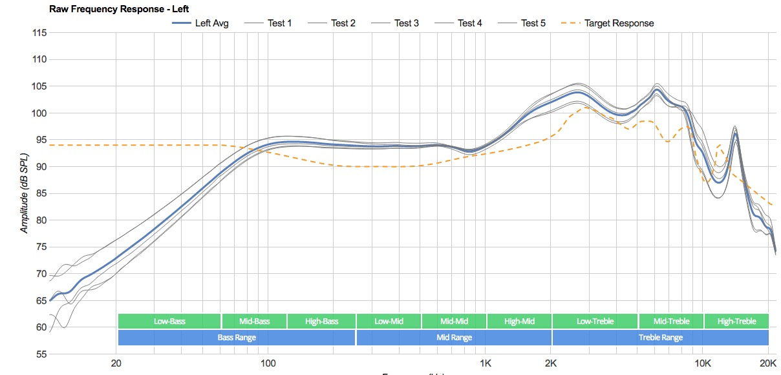
HEADPHONES: In-ear and earbuds
convenient, cheap
Poor comfort, poor bass response
iPod earphone frequency response chart via rtings.com
https://www.koss.com

Slide 27
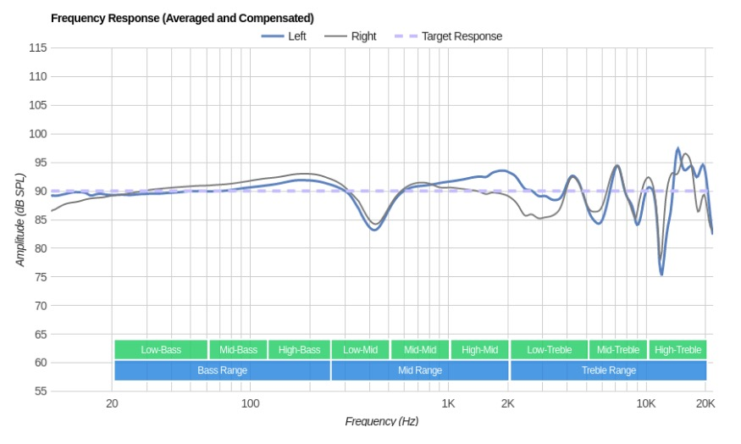
HEADPHONES: On-Ear
cost-effective, light/compact, portable
Slightly less bass
Frequency response—Audio Technica ATH-M60x
Via rtings.com
https://eu.audiotechnica.com

Slide 28
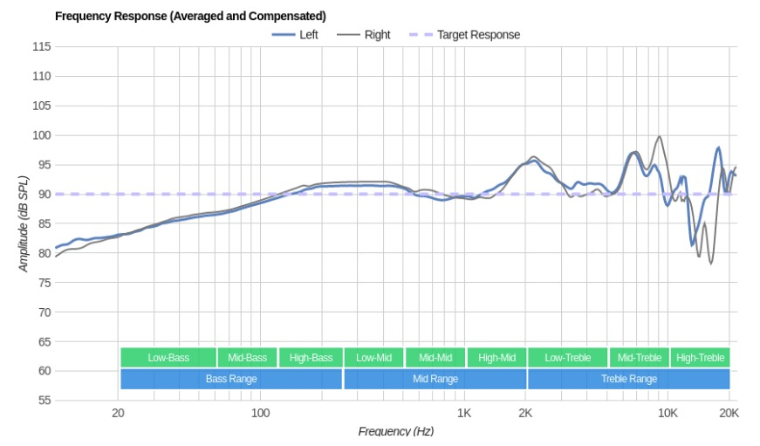
HEADPHONES: Over-Ear
Best sound for monitoring, comfortable
bulky, more sound leakage
Frequency response—AKG Q701
Via rtings.com
https://www.akg.com

